Slide 1
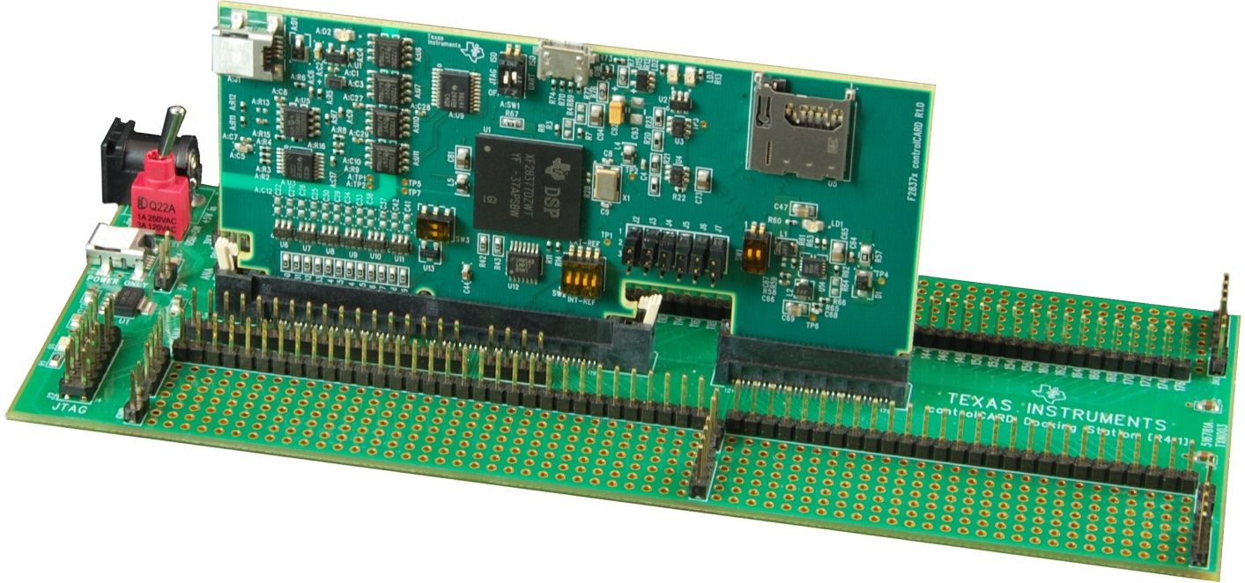
F2837xD Workshop
Technical Training Organization
C2000 is a trademark of Texas Instruments.
Copyright © 2014 Texas Instruments. All rights reserved.

Slide 2


Outline
Workshop Introduction
Architectural Overview
Programming Development Environment
Lab 1: Using Code Composer Studio with the F2837xD
Reset, Interrupts and System Initialization
Analog Subsystem
Lab 2: Configuring the ADC as a data acquisition system
Control Peripherals
Lab 3: Generating a PWM waveform
Inter-Processor Communications (IPC)
Lab 4: Data transfer using Inter-Processor Communications
Support Resources

Slide 3
Outline
Workshop Introduction
Architectural Overview
Programming Development Environment
Lab 1: Using Code Composer Studio with the F2837xD
Reset, Interrupts and System Initialization
Analog Subsystem
Lab 2: Configuring the ADC as a data acquisition system
Control Peripherals
Lab 3: Generating a PWM waveform
Inter-Processor Communications (IPC)
Lab 4: Data transfer using Inter-Processor Communications
Support Resources

Slide 4
Required Workshop Materials
http://processors.wiki.ti.com/index.php/F2837xD_Workshop
F2837xD Experimenter’s Kit
Install Code Composer Studio v6.0.1
Run the workshop installer
F2837xD Workshop-1.1-Setup.exe
Lab Files / Solution Files
Student Guide and Documentation

Slide 5
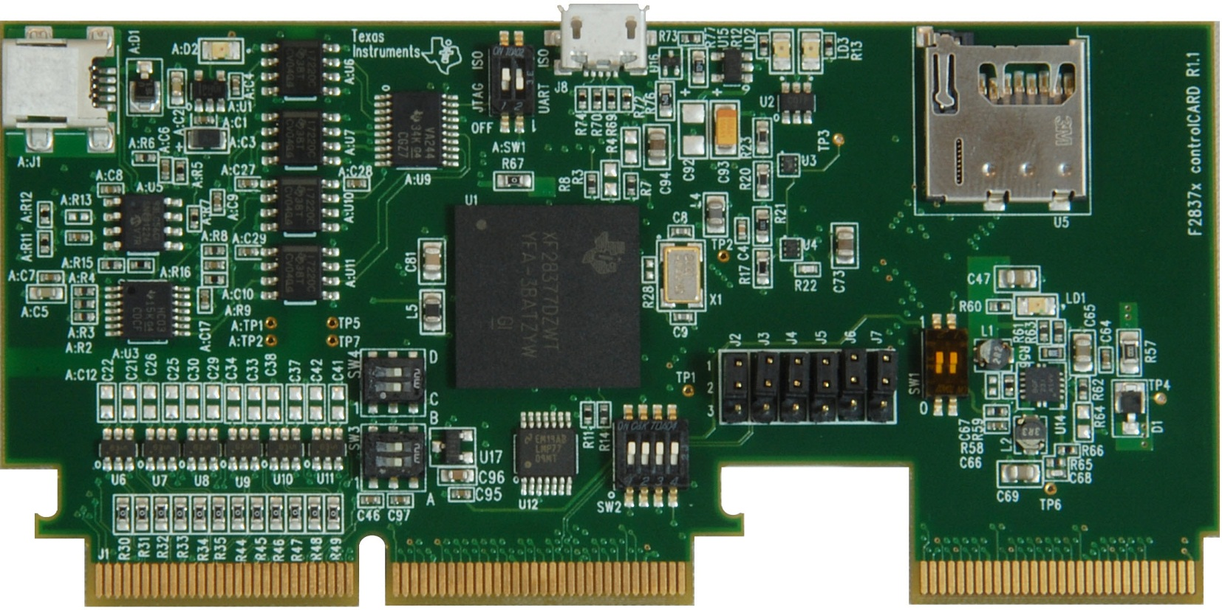
F28377D controlCARD
A:J1 - USB emulation/ UART
A:SW1 - isolated emulation and UART communication enable switch
J8: Host/ Device
LED LD2: GPIO31 (red)
LED LD3: GPIO34 (red)
U5: µSD card
LED LD1: Power (green)
XDS100v2 emulation and isolation circuitry
SW4: ADC VREFHI ADC C & D
SW3: ADC VREFHI ADC A & B
TMS320F28377D
SW2: External VREFHI disable
J2 - J7: USB PHY connection enable jumpers
SW1: Boot Modes

Slide 6
F28x7x Piccolo / Delfino Comparison
 | F2807x | F2837xS | F2837xD
C28x CPUs | 1 | 1 | 2
Clock | 120 MHz | 200 MHz | 200 MHz
Flash / RAM / OTP | 256Kw / 50Kw / 2Kw | 512Kw / 82Kw / 2Kw | 512Kw / 102Kw / 2Kw
On-chip Oscillators |  |  | 
Watchdog Timer |  |  | 
ADC | Three 12-bit | Four 12/16-bit | Four 12/16-bit
Buffered DAC | 3 | 3 | 3
Analog COMP w/DAC |  |  | 
FPU |  |  |  (each CPU)
6-Channel DMA |  |  |  (each CPU)
CLA |  |  |  (each CPU)
VCU / TMU |  /  |  /  |  /  (each CPU)
ePWM / HRPWM |  /  |  /  |  / 
eCAP / HRCAP |  /  |  /  |  / 
eQEP |  |  | 
SCI / SPI / I2C |  /  /  |  /  /  |  /  / 
CAN / McBSP / USB |  /  /  |  /  /  |  /  / 
UPP | - |  | 
EMIF | 1 | 2 | 2

Slide 7
F28x Piccolo / Delfino Comparison
 | F2806x | F2833x | F2837xD
C28x CPUs | 1 | 1 | 2
Clock | 90 MHz | 150 MHz | 200 MHz
Flash / RAM / OTP | 128Kw / 50Kw / 1Kw | 256Kw / 34Kw / 1Kw | 512Kw / 102Kw / 2Kw
On-chip Oscillators |  | - | 
Watchdog Timer |  |  | 
ADC | One 12-bit (SOC) | One 12-bit (SEQ) | Four 12/16-bit (SOC)
Buffered DAC | - | - | 3
Analog COMP w/DAC |  | - | 
FPU |  |  |  (each CPU)
6-Channel DMA |  |  |  (each CPU)
CLA |  | - |  (each CPU)
VCU / TMU |  / - | - / - |  /  (each CPU)
ePWM / HRPWM |  /  |  /  |  / 
eCAP / HRCAP |  /  |  / - |  / 
eQEP |  |  | 
SCI / SPI / I2C |  /  /  |  /  /  |  /  / 
CAN / McBSP / USB |  /  /  |  /  / - |  /  / 
UPP | - | - | 
EMIF | - | 1 | 2

Slide 8
Outline
Workshop Introduction
Architectural Overview
Programming Development Environment
Lab 1: Using Code Composer Studio with the F2837xD
Reset, Interrupts and System Initialization
Analog Subsystem
Lab 2: Configuring the ADC as a data acquisition system
Control Peripherals
Lab 3: Generating a PWM waveform
Inter-Processor Communications (IPC)
Lab 4: Data transfer using Inter-Processor Communications
Support Resources

Slide 9
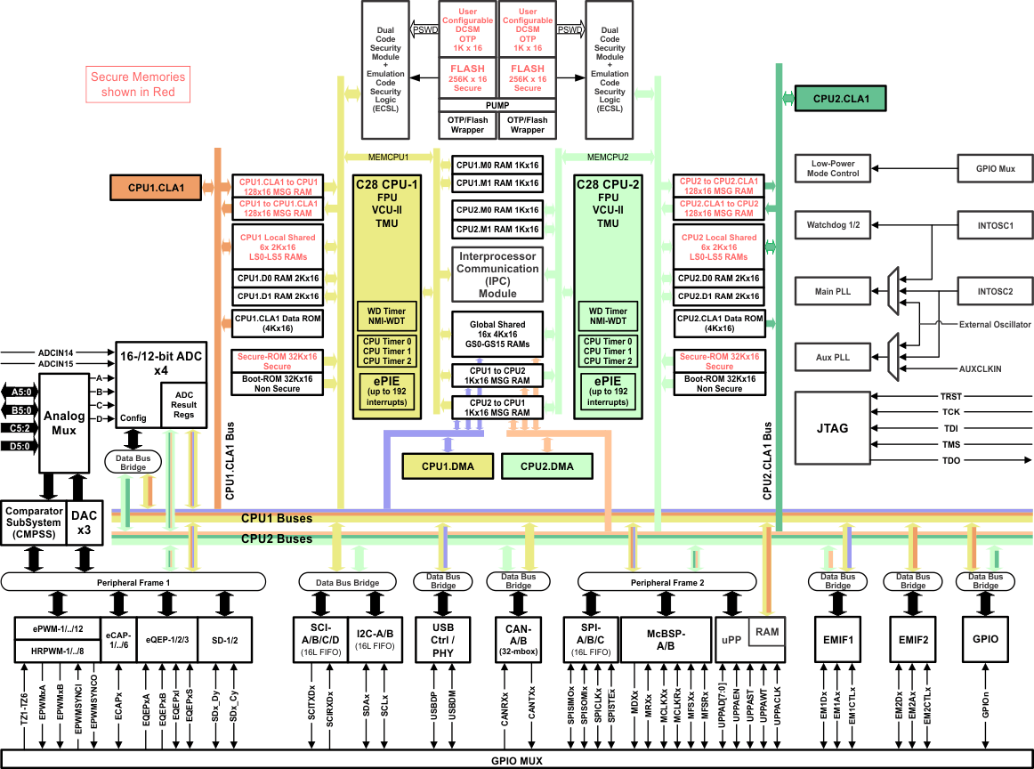
F2837xD – Dual Core Block Diagram

Slide 10
TMS320F28x7x Core Block Diagram
Program Bus
ePWM
eCAP
Boot
ROM
Sectored
Flash
RAM
DMA
6 Ch.
eQEP
ADC
DMA Bus
CLA Bus
McBSP
EMIF
I2C
External Memory
Interfaces
PIE Interrupt Manager
SCI
Trigonometric
Math Unit
32x32 bit
Multiplier
FPU
R-M-W
Atomic
ALU
TMU
VCU
CLA
SPI
Viterbi/Complex
Math Unit
CAN 2.0B
Programmable
Control Law
Accelerator
Watchdog
3
32-bit
Timers
USB 2.0
Multichannel
Buffered Serial
Ports
Register Bus
CPU
GPIO
Data Bus

Slide 11
F28x CPU + FPU + VCU + TMU and CLA
MCU/DSP balancing code density & execution time
16-bit instructions for improved code density
32-bit instructions for improved execution time
32-bit fixed-point CPU + FPU
32x32 fixed-point MAC, doubles as dual 16x16 MAC
IEEE Single-precision floating point hardware and MAC
Floating-point simplifies software development and boosts performance
Viterbi, Complex Math, CRC Unit (VCU) adds support for Viterbi decode, complex math and CRC operations
Parallel processing Control Law Accelerator (CLA) adds IEEE Single-precision 32-bit floating point math operations
CLA algorithm execution is independent of the main CPU
Trigonometric operations supported by TMU
Fast interrupt service time
Single cycle read-modify-write instructions
Program Bus
CLA Bus
32x32 bit
Multiplier
FPU
R-M-W
Atomic
ALU
TMU
VCU
CLA
PIE
Register Bus
3
32-bit
Timers
CPU
Watchdog
Data Bus

Slide 12
Simplified F28x7x Memory Map
0x000000
M0 RAM (1Kw)
0x000400
0x00C000
GS0 – GS15 RAM (4Kw each)
M1 RAM (1Kw)
LS0 – LS5 RAM
accessible by
CPU & CLA
0x000D00
0x03F800
CPU2 to CPU1 IPC MSG RAM (1Kw)
PIE Vectors (512w)
0x03FC00
CPU1 to CPU2 IPC MSG RAM (1Kw)
GS0 – GS15
and EMIF1
accessible by DMA
(only GS0 – GS7
RAM on F2807x)
0x001480
CLA to CPU MSG RAM (128w)
0x001500
0x078000
CPU to CLA MSG RAM (128w)
User OTP (1Kw)
0x002000
0x080000
EMIF-2 (4Kw)
FLASH (256Kw)
Notes:
Only EMIF-1 on F2807x
IPC MSG RAMs only on F2837xD
512Kw FLASH on F2837xS
0x008000
0x100000
LS0 – LS5 RAM (2Kw each)
EMIF-1 (2.9Mw)
0x00B000
D0 – D1 RAM (2Kw each)
0x3F8000
Boot ROM (32Kw)
BROM Vectors (64w)
0x3FFFC0

Slide 13
F28x Fast Interrupt Response Manager
192 dedicated PIE vectors
No software decision making required
Direct access to RAM vectors
Auto flags update
Concurrent auto context save
Peripheral Interrupts 12x16 = 192
PIE
Register
Map
PIE module For 192 interrupts
28x CPU Interrupt logic
INT1 to INT12
28x
CPU
192
12 interrupts
IFR
IER
INTM
Auto Context Save
T ST0
AH AL
PH PL
AR1 (L) AR0 (L)
DP ST1
DBSTAT IER
PC(msw) PC(lsw)

Slide 14
Direct Memory Access (DMA)
PIE
DINTCH1-6
ADC
Result 0-15
McBSP
DMA
6-channels
SPI
GS0 RAM
GS15 RAM
Triggers
PWM1
PWM2
IPC RAM
ADCA/B/C/D (1-4, EVT)
MXEVTA/B MREVTA/B
XINT1-5 TINT0-2
ePWM1-12 (SOCA-B)
SD1FLT1-4 SD2FLT1-4
SPITX/RX (A-C)
USBA_EPx_RX/TX1-3
software
PWM11
PWM12
EMIF
Transfers data between peripherals and/or memory without intervention from the CPU

Slide 15
Control Law Accelerator (CLA)
ADC
&
CMP
C28x CPU
PWM
CLA
An independent 32-bit floating-point math accelerator
Executes algorithms independently and in parallel with the main CPU
Direct access to ePWM, HRPWM, eCAP, eQEP, ADC result, CMPSS, DAC, SDFM, SPI, McBSP, and uPP registers
Responds to peripheral interrupts independent of the CPU
Frees up the CPU for other tasks (communications and diagnostics)

Slide 16
Viterbi / Complex Math Unit (VCU-II)
Extends C28x instruction set to support:
Viterbi operations
Decode for communications
Complex math
16-bit fixed-point complex FFT
used in spread spectrum communications, and many signal processing algorithms
Complex filters
used to improve data reliability, transmission distance, and power efficiency
Power Line Communications (PLC) and radar applications
Cyclic Redundancy Check (CRC)
Communications and memory robustness checks
Other: OFDM interleaving & de-interleaving, Galois Field arithmetic, AES acceleration
VCU execution registers
VCU-II
動態演算法
VSTATUS
VR0
Data path logic for VCU-II Instruction
General instructions
CRC instructions
Arithmetic instructions
Galois Field instructions
Complex FFT instructions
VR1
VR2
VR3
SMO to SM63
VR4
VR5
VR6
VR7
VR8
VCU II Control Logic
資料傳遞之可靠度
VT0
VT1
VCRC

Slide 17
Trigonometric Math Unit (TMU)
y
Adds instructions to FPU for calculating common Trigonometric operations
r
r = sqrt(x² + y²)
rad = atan(y/x)
y = r * sin(rad)
x
x = r * cos(rad)
Operation | Instruction | Exe Cycles | Result Latency | FPU Cycles w/o TMU
Z = Y/X | DIVF32 Rz,Ry,Rx | 1 | 5 | ~24
Y = sqrt(X) | SQRTF32 Ry,Rx | 1 | 5 | ~26
Y = sin(X/2pi) | PUSINF32 Ry,Rx | 1 | 4 | ~33
Y = cos(X/2pi) | PUCOSF32 Ry,Rx | 1 | 4 | ~33
Y = atan(X)/2pi | PUATANF32 Ry,Rx | 1 | 4 | ~53
Instruction To Support ATAN2 Calculation | QUADF32 Rw,Rz,Ry,Rx ATANPUF32 Ra,Rz ADDF32 Rb,Ra,Rw | 3 | 11 | ~90
Y = X * 2pi | MPY2PIF32 Ry,Rx | 1 | 2 | ~4
Y = X * 1/2pi | DIV2PIF32 Ry,Rx | 1 | 2 | ~4
Supported by natural C and C-intrinsics
Significant performance impact on algorithms such as:
• Park/ Inverse Park • DQ0 Transform & Inverse DQ0
• Space Vector GEN • FFT Magnitude & Phase Calculations

Slide 18
External Memory Interface (EMIF)
Provides a means for the CPU, DMA, and CLA to connect to various memory devices
Support for synchronous (SDRAM) and asynchronous (SRAM, NOR Flash) memories
F2837xD includes two EMIFs
EMIF1 – 16/32-bit interface shared between CPU1 and CPU2
EMIF2 – 16-bit interface dedicated to CPU1
CPU1
CPU1
CPU1.DMA1
Arbiter/
Memory
Protection
16/32-Bit
Interface
Arbiter/
Memory
Protection
16-Bit
Interface
CPU2
EMIF1
EMIF2
CPU1.CLA1
CPU2.DMA1
EMIF1 shared between CPU1 & CPU2
EMIF2 dedicated to CPU1

Slide 19
Communication Peripherals
Four Serial Communication Interfaces (SCI) with 16-level deep TX/RX FIFOs
Three Serial Peripheral Interfaces (SPI) with 16-level deep TX/RX FIFOs
Two Inter-Integrated Circuit Interfaces (I2C) with 16-level deep TX/RX FIFOs
Two Multi-channel Buffered Serial Ports (McBSP) with double-buffered TX and triple-buffered RX
Two Controller Area Network Ports (CAN) with 32 mailboxes each
One USB + PHY port

Slide 20
On-Chip Safety Features
Memory Protection
ECC and parity enabled RAMs, shared RAMs protection
ECC enabled flash memory
Clock Checks
Missing clock detection logic
PLLSLIP detection
NMIWDs
Windowed watchdog
Write Register Protection
LOCK protection on system configuration registers
EALLOW protection
CPU1 and CPU2 PIE vector address validity check
Annunciation
Single error pin for external signalling of error
error correction code

Slide 21
Outline
Workshop Introduction
Architectural Overview
Programming Development Environment
Lab 1: Using Code Composer Studio with the F2837xD
Reset, Interrupts and System Initialization
Analog Subsystem
Lab 2: Configuring the ADC as a data acquisition system
Control Peripherals
Lab 3: Generating a PWM waveform
Inter-Processor Communications (IPC)
Lab 4: Data transfer using Inter-Processor Communications
Support Resources

Slide 22
Programming Model: Header Files & API
CPU and Peripherals → Header Files
USB & CAN → API Drivers
Software
API Drivers
C functions automatically set register bit fields
Common tasks and peripheral modes supported
Reduces learning curve and simplifies programming
Bit Fields
C structures – Peripheral Register Header Files
Register access whole or by bits and bit fields are manipulated without masking
Ease-of-use with CCS IDE
Registers and Addresses
Assembly language used to program hardware registers and access addresses
Direct use of header files
API Drivers
Hardware Abstraction
Bit Fields
Registers and Addresses
Hardware

Slide 23
Programming Model: Comparison
Direct Register Access
Bit Field Header Files
API Driver
//Interrupts set up elsewhere
//Set duty cycle
MOVB @9,#0x0F,UNC
//Set PWM1A on Zero Event
AND AL,@11,#0xFFFC
ORB AL,#0x02
MOV @11,AL
//Clear PWM1A on Up-count //CompareA event
AND AL,@11,#0xFFCF
ORB AL,#0x10
MOV @11,AL
interrupt void IsrAdc(void)
{
//Period of ePWM1 is set in //init; Multiply period by //desired duty to get CMPA //value;
EPwm1Regs.CMPA.half.CMPA = EPwm1Regs.TBPRD * duty;
}
interrupt void IsrAdc(void)
{
/* set a new pwm value */
PWM_setDutyA(PWM_MODULE_2, duty);
}
Device support package includes documentation and examples showing how to use the Bit Field Header Files or API Driver Library
Device support packages located at: C:\TI\controlSUITE\device_support\
controlSUITE located at http://www.ti.com and enter “controlSUITE” in the keyword search box

Slide 24
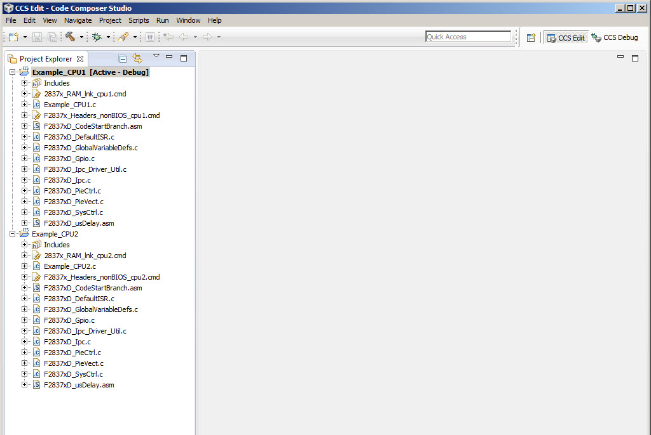
Code Composer Studio: IDE
Integrates: edit, code generation, and debug
Single-click access using buttons
Powerful graphing/profiling tools
Automated tasks using Scripts
Based on the Eclipse open source software framework

Slide 25
CCS – Software Development
Build
Code
Simulator
Compile
lnk.cmd
Development
Tool
Asm
Link
Debug
Editor
External
Emulator
Libraries
Graphs,
Profiling
MCU
Board
Code Composer Studio includes:
Integrated Edit/Debug GUI
Code Generation Tools
TI-RTOS

Slide 26
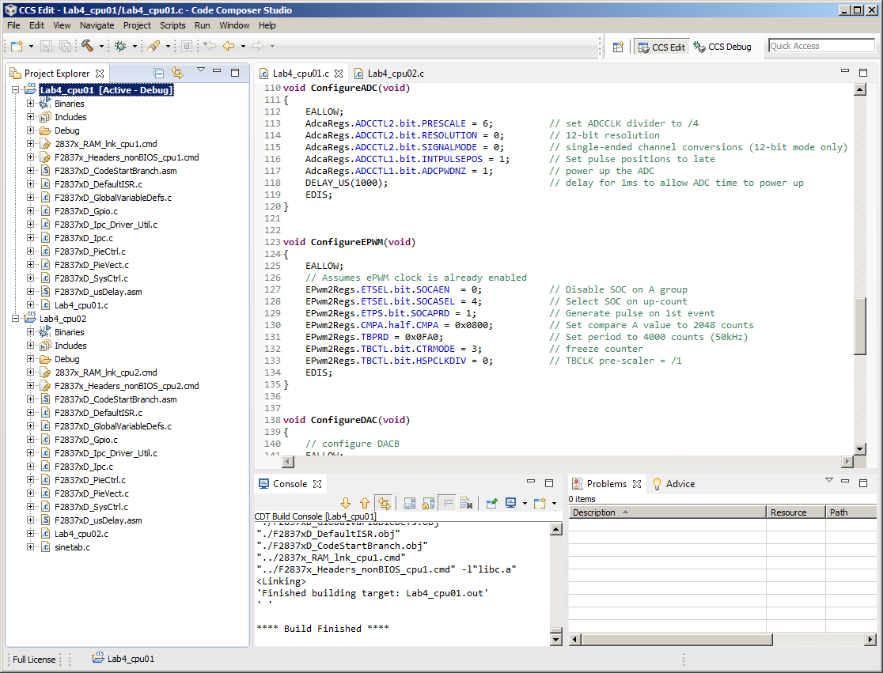
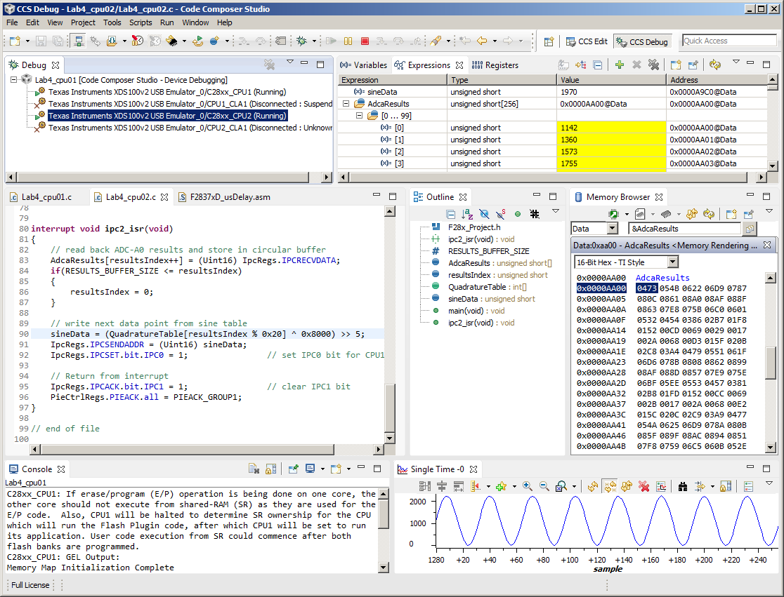
Edit and Debug Perspective
Each perspective provides a set of functionality aimed at accomplishing a specific task
Edit Perspective
Displays views used during code development
C/C++ project, editor, etc.
Debug Perspective
Displays views used for debugging
Menus and toolbars associated with debugging, watch and memory windows, graphs, etc.

Slide 27
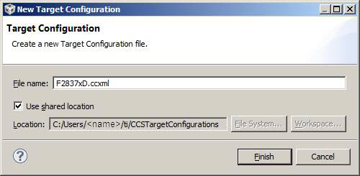
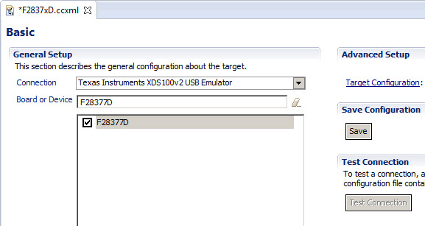
Creating a Target Configuration
File → New → Target Configuration File
Select connection type
Select device
Save configuration

Slide 28
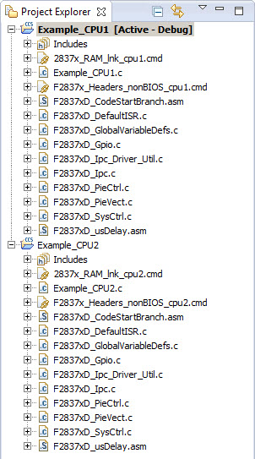
CCSv6 Project
Project files contain:
List of files:
Source (C, assembly)
Libraries
SYS/BIOS configuration file
Linker command files
Project settings:
Build options (compiler, assembler, linker, and TI-RTOS)
Build configurations

Slide 29
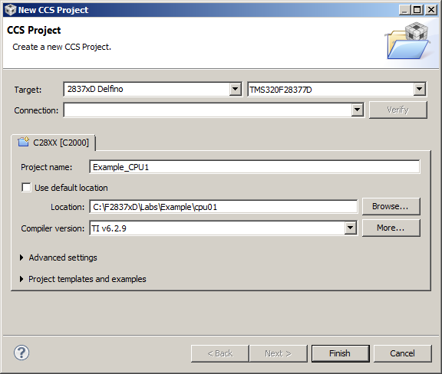

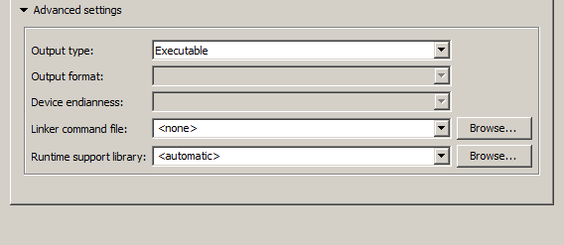
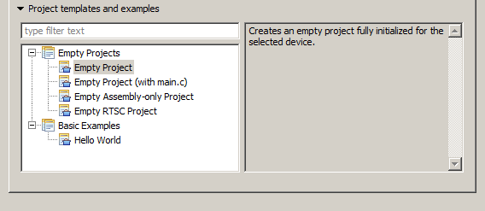
Creating a New CCSv6 Project(s)
File → New → CCS Project
CPU1
CPU2
Advanced Setting / Project Templates and Examples

Slide 30
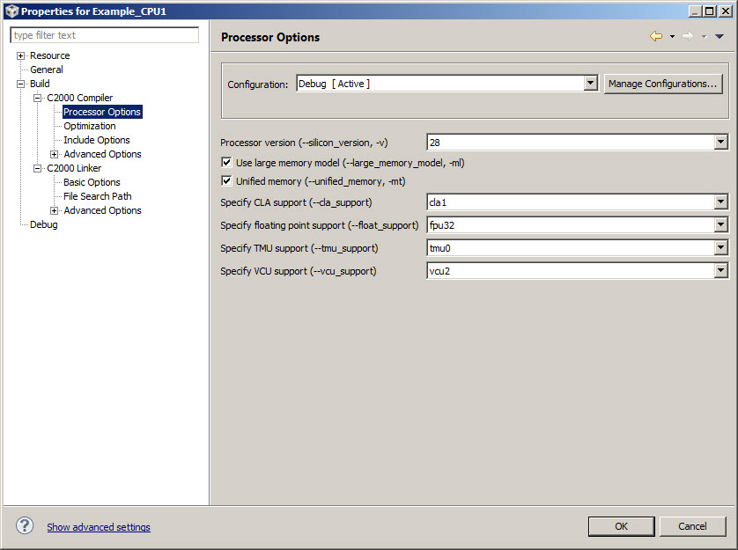
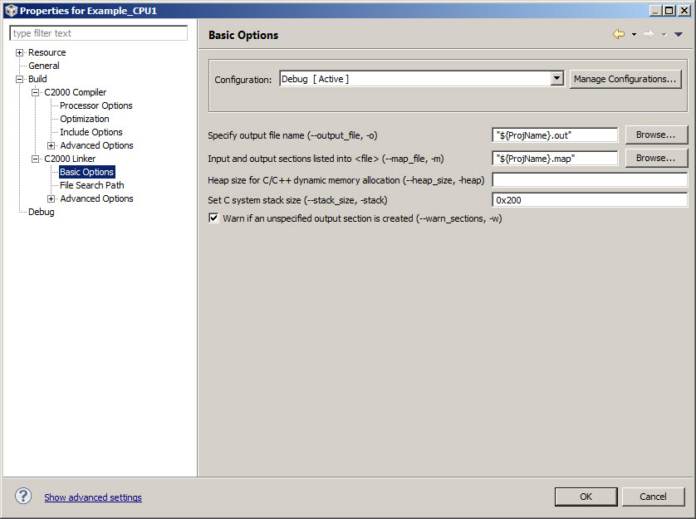
CCSv6 Build Options – Compiler / Linker
Separate build options for each project – CPU1 & CPU2
Compiler
Categories for code generation tools – controls many aspects of the build process, such as:
Optimization level
Target device
Compiler / assembly / link options
Linker
Categories for linking – specify various link options
${PROJECT_ROOT} specifies the current project directory

Slide 31
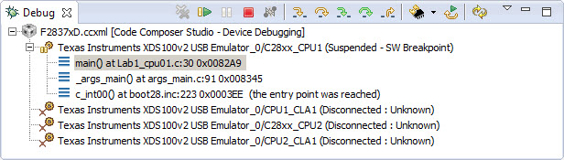
Launching Dual Subsystem Debug (1)
1st subsystem (CCS Edit Perspective) -
Clicking “Debug” button will automatically:
Launch the debugger
Connects to target
Programs flash memory
Note 2nd subsystem is disconnected
Next step will connect 2nd subsystem

Slide 32
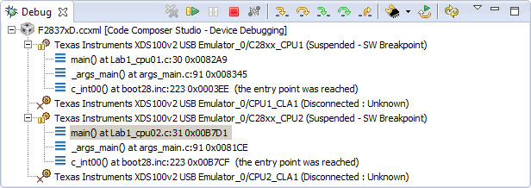
Launching Dual Subsystem Debug (2)
2nd subsystem (CCS Debug Perspective) -
In Debug window right-click on emulator and select “Connect target”
Highlight emulator and load program (flash)
Run → Load → Load Program…
Both subsystems are connected
Next step is dual subsystem start-up sequence

Slide 33
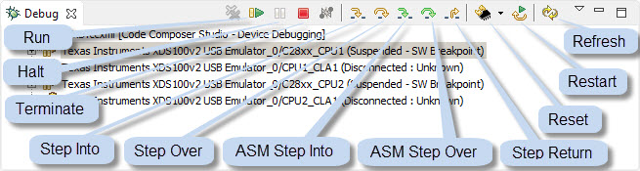
Dual Subsystem Debug Start-up
Start-up sequence
Reset CPU1 subsystem
Reset CPU2 subsystem
Run CPU1 subsystem
Run CPU2 subsystem
Stop and debug either subsystem
Debug window controls “selected” subsystem for the debug interaction
Highlight appropriate subsystem for debug

Slide 34
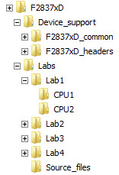
Lab File Directory Structure
Supporting Files and Libraries
Easier to make projects portable
${PROJECT_ROOT} provides an anchor point for paths to files that travel with the project
Easier to maintain and update supporting files and libraries
Source Files are “Added” to
the Project Folder
Original Source Files
All modified files are in the Project Folder
Original source files are always available for reuse, if a file becomes corrupted
Note: CCSv6 will automatically add ALL files contained in the folder where the project is created

Slide 35
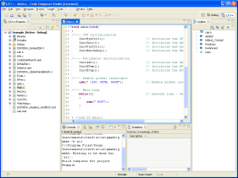
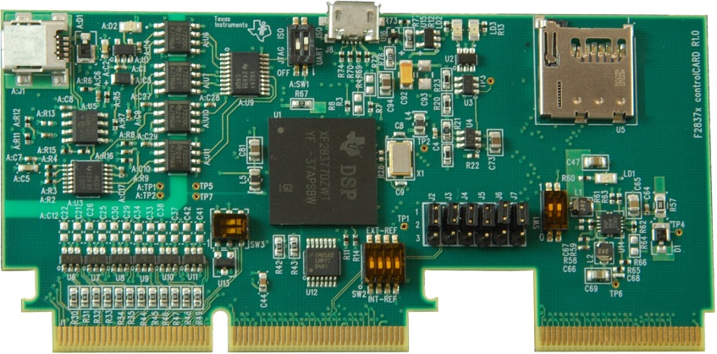
Lab1: Dual-Core Debug with F2837xD
LED LD2
LED LD3
Use Code Composer Studio (CCS) in dual-core debug environment
Set up target configuration
Create CPU1 project
CPU1 blinks LED LD2 (software delay loop)
Load and run CPU2 project
CPU2 blinks LED LD3 (software delay loop)

Slide 36
Outline
Workshop Introduction
Architectural Overview
Programming Development Environment
Lab 1: Using Code Composer Studio with the F2837xD
Reset, Interrupts and System Initialization
Analog Subsystem
Lab 2: Configuring the ADC as a data acquisition system
Control Peripherals
Lab 3: Generating a PWM waveform
Inter-Processor Communications (IPC)
Lab 4: Data transfer using Inter-Processor Communications
Support Resources

Slide 37
Reset Sources
Missing Clock Detect
F28x7x
Watchdog Timer *
Power-on Reset
XRS
Hibernate Reset
省電模式
XRS pin active
To XRS pin
Logic shown is functional representation, not actual implementation
* = CPU1.WD resets both cores and CPU2.WD resets CPU2 only
POR – Power-on Reset generates a device reset during power-up conditions
RESC – Reset Cause register contains the cause of the last reset (sticky bits maintain state with multiple resets)
Note: Only F2807x devices support an on-chip voltage regulator (VREG) to generate the core voltage.

Slide 38
Dual-Core Boot Process
CPU1 starts execution from CPU1 boot ROM while CPU2 is held in reset
CPU1 controls the boot process
CPU2 goes through its own boot process under the control of CPU1 – except when CPU2 is set to boot-to-flash
IPC registers are used to communicate between CPU1 and CPU2 during the boot process

Slide 39
Reset – Bootloader
Reset
ENPIE = 0
INTM = 1
Reset vector fetched from boot ROM
0x3F FFC0
CPU2 held in reset until released by CPU1.
CPU2
YES
Emulator Connected ?
NO
TRST = 1
TRST = 0
Emulation Boot
Boot determined by
EMU_BOOTCTRL:
EMU_KEY and EMU_BMODE
Stand-alone Boot
Boot determined by
2 GPIO pins and
ZxOTP_BOOTCTRL:
OTP_KEY and OTP_BMODE
EMU_BOOTCTRL register located in PIE RAM at 0x000D00
Z1OTP_BOOTCTRL register located in OTP at 0x07801E
Z2OTP_BOOTCTRL register located in OTP at 0x07821E
TRST = JTAG Test Reset

Slide 40
Emulation Boot Mode (TRST = 1) slide 1 of 2
Emulator Connected
Emulation Boot
Boot determined by
EMU_BOOTCTRL :
EMU_KEY and EMU_BMODE
If either EMU_KEY or EMU_BMODE are invalid, the “wait” boot mode is used. These values can then be modified using the debugger and a reset issued to restart the boot process.
NO
Boot Mode
Wait
EMU_KEY = 0x5A ?
YES
GPIO 72 GPIO 84
0 0
0 1
1 0
1 1
Boot Mode
Parallel I/O
SCI-A
Wait
GetMode
EMU_BMODE = 0xFE ?
CPU1 only
YES
Boot pins can be mapped to any GPIO pins. GetMode reads ZxOTP_BOOTCTRL (not the boot pins).
NO
YES
Boot Mode
Emulate CPU1/2 Stand-Alone
EMU_BMODE = 0xFF ?
Reads OTP for boot pins and boot mode.
NO
CPU1 EMU_BOOTCTRL Register
CPU2 EMU_BOOTCTRL Register
31 – 24
23 – 16
15 – 8
7 – 0
31 – 24
23 – 16
15 – 8
7 – 0
EMU_BOOTPIN1
EMU_BOOTPIN0
EMU_BMODE
EMU_KEY
reserved
reserved
EMU_BMODE
EMU_KEY

Slide 41
Emulation Boot Mode (TRST = 1) slide 2 of 2
Continued from previous slide
OTP_KEY = 0x5A ?
NO
Boot Mode
FLASH
EMU_BMODE =
0x00
0x01
0x03
0x04
0x05
0x07
0x0A
0x0B
other
0x0C
0x81
0x84
0x85
0x87
Boot Mode
Parallel I/O
SCI-A
GetMode
SPI-A
I2C-A
CAN-A
M0 SARAM
FLASH
Wait
USB-0
SCI-A *
SPI-A *
I2C-A *
CAN-A *
YES
OTP_BMODE =
0x00
0x01
0x04
0x05
0x07
0x0A
0x0B
0x0C
other
0x81
0x84
0x85
0x87
Boot Mode
Parallel I/O
SCI-A
SPI-A
I2C-A
CAN-A
M0 SARAM
FLASH
USB-0
Wait
SCI-A *
SPI-A *
I2C-A *
CAN-A *
CPU1 & CPU2
CPU1 GetMode
CPU1 only
* Alternate RX/TX GPIO pin mapping for CPU1 only
OTP_BMODE =
0x0B
other
Boot Mode
FLASH
Wait
CPU2 GetMode

Slide 42
Stand-Alone Boot Mode (TRST = 0)
Emulator Not Connected
Stand-alone Boot
Boot determined by
2 GPIO pins and
ZxOTP_BOOTCTRL :
OTP_KEY and OTP_BMODE
OTP_BMODE =
0x00
0x01
0x04
0x05
0x07
0x0A
0x0B
0x0C
other
0x81
0x84
0x85
0x87
Boot Mode
Parallel I/O
SCI-A
SPI-A
I2C-A
CAN-A
M0 SARAM
FLASH
USB-0
Wait
SCI-A *
SPI-A *
I2C-A *
CAN-A *
GPIO GPIO
72 84
0 0
0 1
1 0
1 1
CPU1 GetMode
Boot Mode
Parallel I/O
SCI
Wait
GetMode
CPU1 only
Use
Z1OTP_
BOOTCTRL
Z1OTP_BOOTCTRL
OTP_KEY = 0x5A ?
YES
OTP_BMODE =
0x0B
other
Boot Mode
FLASH
Wait
CPU2 GetMode
NO
Use
Z2OTP_
BOOTCTRL
Z2OTP_BOOTCTRL
OTP_KEY = 0x5A ?
YES
CPU1 ZxOTP_BOOTCTRL Register
31 – 24
23 – 16
15 – 8
7 – 0
OTP_BOOTPIN1
OTP_BOOTPIN0
OTP_BMODE
OTP_KEY
NO
CPU2 ZxOTP_BOOTCTRL Register
Boot Mode
FLASH
31 – 24
23 – 16
15 – 8
7 – 0
reserved
reserved
OTP_BMODE
OTP_KEY

Slide 43
Reset Code Flow - Summary
0x000000
M0 SARAM (1Kw)
0x000000
0x080000
FLASH (512Kw)
0x3F7FF6
0x3F8000
Boot ROM (32Kw)
Execution Entry
determined by
Emulation Boot Mode or
Stand-Alone Boot Mode
Boot Code
InitBoot
•
•
•
•
BROM vector (64w)
RESET
0x3FFFC0
* reset vector
Bootloading
Routines
(SCI, SPI, I2C, USB, CAN, Parallel I/O)
* reset vector = 0x3FEAC2 for CPU1; 0x3FE649 for CPU2

Slide 44
Interrupt Sources
Internal Sources
TINT2
F28x CORE
TINT1
TINT0
XRS
ePWM, eCAP, eQEP, ADC, SCI, SPI, I2C, eCAN, McBSP,
DMA, CLA, WD
NMI
PIE
(Peripheral
Interrupt
Expansion)
INT1
INT2
INT3
•
•
External Sources
•
INT12
INT13
XINT1 – XINT5
INT14
TZx
XRS

Slide 45
Maskable Interrupt Processing Conceptual Core Overview
Core
Interrupt
(IFR)
“Latch”
(IER)
“Switch”
(INTM)
“Global Switch”
INT1
1
INT2
0
F28x
Core
INT14
1
A valid signal on a specific interrupt line causes the latch to display a “1” in the appropriate bit
If the individual and global switches are turned “on” the interrupt reaches the core

Slide 46
Core Interrupt Registers
產生interrupt
Interrupt Flag Register (IFR)
(pending = 1 / absent = 0)
15
14
13
12
11
10
9
8
RTOSINT
DLOGINT
INT14
INT13
INT12
INT11
INT10
INT9
INT8
INT7
INT6
INT5
INT4
INT3
INT2
INT1
7
6
5
4
3
2
1
0
Interrupt Enable Register (IER)
(enable = 1 / disable = 0)
15
14
13
12
11
10
9
8
RTOSINT
DLOGINT
INT14
INT13
INT12
INT11
INT10
INT9
INT8
INT7
INT6
INT5
INT4
INT3
INT2
INT1
7
6
5
4
3
2
1
0
Interrupt Global Mask Bit (INTM)
Bit 0
ST1
INTM
(enable = 0 / disable = 1)
/*** Interrupt Enable Register ***/
extern cregister volatile unsigned int IER;
IER |= 0x0008; //enable INT4 in IER
IER &= 0xFFF7; //disable INT4 in IER
/*** Global Interrupts ***/
asm(“ CLRC INTM”); //enable global interrupts
asm(“ SETC INTM”); //disable global interrupts

Slide 47
Peripheral Interrupt Expansion - PIE
PIE module for 192 Interrupts
Interrupt Group 1
PIEIFR1
PIEIER1
INT1.y interrupt group
INT1.1
1
INT2.y interrupt group
INT1.2
0
INT3.y interrupt group
INT1
•
•
INT4.y interrupt group
•
•
•
•
INT5.y interrupt group
INT1.16
1
INT6.y interrupt group
Peripheral Interrupts 12 x 16 = 192
192
INT7.y interrupt group
Core Interrupt logic
INT8.y interrupt group
INT9.y interrupt group
INT1 – INT12
INT10.y interrupt group
28x
Core
12 Interrupts
IFR
IER
INTM
INT11.y interrupt group
INT12.y interrupt group
INT13
(TINT1)
INT14
(TINT2)
NMI

Slide 48
F28377D PIE Assignment Table - Lower
INTx.8
INTx.7
INTx.6
INTx.5
INTx.4
INTx.3
INTx.2
INTx.1
INT1
WAKE
TINT0
ADCD1
XINT2
XINT1
ADCC1
ADCB1
ADCA1
INT2
PWM8_
TZ
PWM7_
TZ
PWM6_
TZ
PWM5_
TZ
PWM4_
TZ
PWM3_
TZ
PWM2_
TZ
PWM1_
TZ
INT3
PWM8
PWM7
PWM6
PWM5
PWM4
PWM3
PWM2
PWM1
INT4
ECAP6
ECAP5
ECAP4
ECAP3
ECAP2
ECAP1
INT5
EQEP3
EQEP2
EQEP1
INT6
MCBSP
B_TX
MCBSP
B_RX
MCBSP
A_TX
MCBSP
A_RX
SPIB_TX
SPIB_RX
SPIA_TX
SPIA_RX
INT7
DMA_CH6
DMA_CH5
DMA_CH4
DMA_CH3
DMA_CH2
DMA_CH1
INT8
SCID_TX
SCID_RX
SCIC_TX
SCIC_RX
I2CB_
FIFO
I2CB
I2CA_
FIFO
I2CA
INT9
DCANB_2
DCANB_1
DCANA_2
DCANA_1
SCIB_TX
SCIB_RX
SCIA_TX
SCIA_RX
INT10
ADCB4
ADCB3
ADCB2
ADCB_
EVT
ADCA4
ADCA3
ADCA2
ADCA_
EVT
INT11
CLA1_8
CLA1_7
CLA1_6
CLA1_5
CLA1_4
CLA1_3
CLA1_2
CLA1_1
INT12
FPU_UF
FPU_OF
VCU
PBIST
XINT5
XINT4
XINT3

Slide 49
F28377D PIE Assignment Table - Upper
INTx.16
INTx.15
INTx.14
INTx.13
INTx.12
INTx.11
INTx.10
INTx.9
INT1
IPC3
IPC2
IPC1
IPC0
INT2
PWM12_
TZ
PWM11_
TZ
PWM10_
TZ
PWM9_
TZ
INT3
EPWM12
EPWM11
EPWM10
EPWM9
INT4
INT5
SD2
SD1
INT6
SPIC_TX
SPIC_RX
INT7
INT8
UPPA
INT9
USBA
INT10
ADCD4
ADCD3
ADCD2
ADCD_
EVT
ADCC4
ADCC3
ADCC2
ADCC_
EVT
INT11
INT12
CLA_UF
CLA_OF
AUX_PLL
_SLIP
SYS_PLL
_SLIP
RAM_ACC
_VIOLAT
FLASH_C
_ERROR
RAM_C_
ERROR
EMIF_
ERROR

Slide 50
PIE Registers
PIEIFRx register (x = 1 to 12)
15
14
13
12
11
10
9
8
7
6
5
4
3
2
1
0
INTx.16
INTx.15
INTx.14
INTx.13
INTx.12
INTx.11
INTx.10
INTx.9
INTx.8
INTx.7
INTx.6
INTx.5
INTx.4
INTx.3
INTx.2
INTx.1
PIEIERx register (x = 1 to 12)
15
14
13
12
11
10
9
8
7
6
5
4
3
2
1
0
INTx.16
INTx.15
INTx.14
INTx.13
INTx.12
INTx.11
INTx.10
INTx.9
INTx.8
INTx.7
INTx.6
INTx.5
INTx.4
INTx.3
INTx.2
INTx.1
PIE Interrupt Acknowledge Register (PIEACK)
15 - 12
11
10
9
8
7
6
5
4
3
2
1
0
reserved
PIEACKx
PIECTRL register
15 - 1
0
PIEVECT
ENPIE
由指令產生interrupt
#include “F2837x_Device.h”
PieCtrlRegs.PIEIFR1.bit.INTx4 = 1; //manually set IFR for XINT1 in PIE group 1
PieCtrlRegs.PIEIER3.bit.INTx2 = 1; //enable PWM2INT in PIE group 3
PieCtrlRegs.PIEACK.all = 0x0004; //acknowledge the PIE group 3
PieCtrlRegs.PIECTRL.bit.ENPIE = 1; //enable the PIE

Slide 51
PIE Block Initialization
Main.c
Memory Map
// CPU Initialization
•
1
•
•
InitPieCtrl();
•
•
PIE RAM
Vectors
512w
(ENPIE = 1)
•
PieVect.c
PieCtrl.c
PIE_VECT_TABLE
// Initialize PIE_RAM
2
2
•
// Base Vectors
•
•
•
•
•
•
memcpy( );
•
•
•
Boot ROM
Reset Vector
•
// Core INT1 re-map
•
•
// Enable PIE Block
•
PieCtrlRegs.
PIECTRL.bit.
ENPIE=1;
•
// Core INT12 re-map
3

Slide 52
PIE Initialization Code Flow - Summary
RESET
<0x3F FFC0>
Reset Vector
<reset vector> = Boot Code
Boot option determines code execution entry point
CodeStartBranch.asm
.sect “codestart”
M0SARAM Entry Point
<0x00 0000> = LB _c_int00
Flash Entry Point
<0x08 0000> = LB _c_int00
OR
_c_int00:
CALL main()
rts2800_fpu32.lib
•
Interrupt
•
•
PIE Vector Table
512 Word RAM
0x00 0D00 – 0EFF
Main.c
Initialization()
{
Load PIE Vectors
Enable the PIE
Enable PIEIER
Enable Core IER
Enable INTM
}
main()
{ initialization();
}
DefaultIsr.c
•
•
interrupt void name(void)
{
}
•
•
•
•

Slide 53
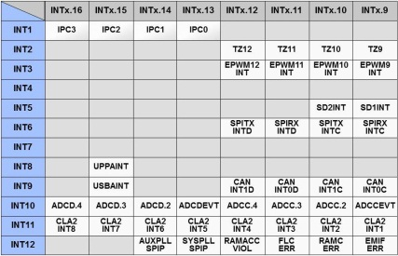
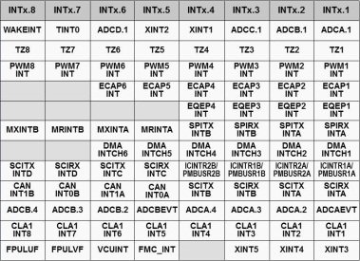
Interrupt Signal Flow – Summary
Peripheral Interrupt Expansion (PIE) – Interrupt Group x
PIEIFRx
PIEIERx
Peripheral
Interrupt
INTx.y
1
PieCtrlRegs.PIEIERx.bit.INTxy = 1;
Core Interrupt Logic
Core
INTx
IFR
IER
INTM
1
IER |= 0x0001;
→ 0x0FFF;
asm(“ CLRC INTM”);
PIE Vector Table
DefaultIsr.c
interrupt void name(void)
{
}
•
•
•
INTx.y → name
(For peripheral interrupts where x = 1 to 12, and y = 1 to 16)

Slide 54
F2837xD Dual-Core Interrupt Structure
Internal Sources
TINT2.1
TINT1.1
CPU1 CORE
TINT0.1
DMA1.1 CLA1.1
NMI
ePWM, eCAP, eQEP,
ADC, SCI, SPI, I2C,
eCAN, McBSP, WD
ePIE.1
INT1
INT2
INT3
•
•
•
External Sources
INT12
INT13
XINT1 – XINT5
INT14
TZx
IPC
XRS
ePIE.2
CPU2 CORE
NMI
INT1
INT2
INT3
•
•
Internal Sources
•
INT12
TINT0.2
DMA1.2 CLA1.2
INT13
TINT1.2
INT14
TINT2.2

Slide 55
F28x7x Oscillator / PLL Clock Module
Internal
OSC 1
(10 MHz)
OSC1CLK
WDCLK
OSCCLKSRCSEL
Internal
OSC 2
(10 MHz)
OSC2CLK
1x
00*
01
OSCCLK
SYSCLKDIV
(PLL bypass)
MUX
1/n
PLLSYSCLK
XCLKIN
(X2 n.c.)
X1
PLL
PLLCLK
XTAL
XTAL OSC
EXTCLK
X2
XCLKOUTSEL
SYSPLLMULT
110
101
101
011
010
001
000*
XCLKOUTDIV
AUXPLLCLK
CPU2.SYSCLK
1/n
XCLKOUT
(GPIO 73)
CPU1.SYSCLK
PLLCLK
PLLSYSCLK
AUXOSCCLKSRCSEL
AUXPLLDIV
00*
01
10
AUX
PLL
AUXCLK
1/n
AUXPLLCLK
AUXCLKIN (from GPIO)
* default

Slide 56
F28x7x PLL and LOSPCP
OSCCLK
ClkCfgRegs.SYSCLKDIVSEL.bit.PLLSYSCLKDIV
(PLL bypass)
MUX
1/n
PLLSYSCLK
CPUx
CPUx.SYSCLK
PLL
PLLCLK
CPUx.LSPCLK
LOSPCP
ClkCfgRegs.SYSPLLMULT.bit.IMULT
ClkCfgRegs.LOSPCP.bit.LSPCLK
ClkCfgRegs.SYSPLLMULT.bit.FMULT
IMULT CLKIN
0 0 0 0 0 0 0 OSCCLK / n * (PLL bypass)
0 0 0 0 0 0 1 OSCCLK x 1 / n
0 0 0 0 0 1 0 OSCCLK x 2 / n
0 0 0 0 0 1 1 OSCCLK x 3 / n
1 1 1 1 1 0 1 OSCCLK x 125/ n
1 1 1 1 1 1 0 OSCCLK x 126 / n
1 1 1 1 1 1 1 OSCCLK x 127 / n
SYSPLL
DIVSEL n
111111 /126
000010 /4 *
000001 /2
000000 /1
LSPCLK Peripheral Clk Freq
0 0 0 CPUx.SYSCLK / 1
0 0 1 CPUx.SYSCLK / 2
0 1 0 CPUx.SYSCLK / 4 *
0 1 1 CPUx.SYSCLK / 6
1 0 0 CPUx.SYSCLK / 8
1 0 1 CPUx.SYSCLK / 10
1 1 0 CPUx.SYSCLK / 12
1 1 1 CPUx.SYSCLK / 14
•
•
•
•
•
•
•
•
•
•
•
•
LSBs in reg. – others reserved
FMULT CLKIN
0 0 Fractional x 0 *
0 1 Fractional x 0.25
1 0 Fractional x 0.5
1 1 Fractional x 0.75
* default

Slide 57
F2837xD Dual-Core System Clock
CPU2
LSPCLKDIV
CPU2.SYSCLK
LOSPCP
CPU2.LSPCLK
PLLSYSCLK
CPU1.SYSCLK
LOSPCP
CPU1.LSPCLK
CPU1
PERx.SYSCLK
PERx.SYSCLK
PERx
CPUSELy
/1, /2
PERx
SCIx
SPIx
PERCLKDIVSEL
EPWMCLK
EPWM
EPWMCLKDIV
CPU2.SYSCLK
INTOSC1
INTOSC2
EXTCLK
AUXPLLCLK
CPU2.TMR2CLKCTL
WD.2
CPUTIMER2.2
WDCLK
WD.1
CPU1.SYSCLK
INTOSC1
INTOSC2
EXTCLK
AUXPLLCLK
CPUTIMER2.1
PERx.SYSCLK
EXTCLK
AUXCLKIN
CANx Bit CLK
CANxBCLKSEL
CPU1.TMR2CLKCTL

Slide 58
Watchdog Timer Module
WDPS
WDOVERRIDE
WDCLK
/512
Watchdog
Prescaler
WDDIS
WDCNTR
8-bit Watchdog
Counter
CLR
CNT
System
Reset
WDRST
Output
Pulse
WDWCR
WDCNTR less than WDWCR
WDINT
55 + AA
Detector
window minimum
Good Key
Watchdog
Reset Key
Register
WDCHK
3
/
/
Bad WDCHK Key
WDKEY
3
1 0 1

Slide 59
F28x7x GPIO Grouping Overview
GPIO Port A Group
Mux1 Register
(GPAGMUX1)
[GPIO 0 to 15]
GPIO Port A Mux1
Register
(GPAMUX1)
[GPIO 0 to 15]
GPIO Port A
Direction Register
(GPADIR)
[GPIO 0 to 31]
Input
Qual
GPIO Port A
GPIO Port A Group
Mux2 Register
(GPAGMUX2)
[GPIO 16 to 31]
GPIO Port A Mux2
Register
(GPAMUX2)
[GPIO 16 to 31]
Internal Bus
GPIO Port F Group
Mux1 Register
(GPFGMUX1)
[GPIO 160 to 175]
GPIO Port F Mux1
Register
(GPFMUX1)
[GPIO 160 to 175]
GPIO Port F
Direction Register
(GPFDIR)
[GPIO 160 to 191]
Input
Qual
GPIO Port F
GPIO Port F Group
Mux2 Register
(GPFGMUX2)
[GPIO 176 to 191]
GPIO Port F Mux2
Register
(GPFMUX2)
[GPIO 176 to 191]

Slide 60
F28x7x GPIO Pin Block Diagram
GPxSET
GPxCLEAR
GPxTOGGLE
0 = Input
1 = Output
•
•
Peripheral 1
0
•
•
Peripheral 2
GPxDIR
01
10
Peripheral 3
00
11
GPxGMUX1/2
Out
GPxDAT
In
•
•
Peripheral 5
4
•
•
Peripheral 6
01
10
Peripheral 7
•
To Input X-Bar
00
11
•
00
01
•
0*
Input
Qualification
10
•
•
Peripheral 9
•
1
Peripheral 10
11
8
•
01
10
•
GPxQSEL1/2
GPxCTRL
Peripheral 11
GPxINV
00
11
•
•
Peripheral 13
12
•
•
Peripheral 14
Internal Pull-Up
0 = enable
(default GPIO 12-xx)
1 = disable
(default GPIO 0-11)
01
10
Peripheral 15
00
11
GPxPUD
Pin
GPxMUX1/2
See device datasheet for pin function selection matrices
Output X-Bar muxed with Peripheral GPIO pins
Logic shown is functional representation, not actual implementation
* = Default x = A, B, C, D, E, or F

Slide 61
F28x7x GPIO Input Qualification
Input
Qualification
to GPIO and peripheral modules
pin
CPUx.SYSCLK
Qualification available on ports A - F
Individually selectable per pin
no qualification (peripherals only)
sync to CPUx.SYSCLK only
qualify 3 samples
qualify 6 samples
samples taken
T
T
T
T = qual period

Slide 62
F28x7x GPIO Input X-Bar

Slide 63
F28x7x GPIO Input X-Bar Architecture
This block diagram is replicated 14 times
GPIO 0
INPUTx
GPIO n
INPUTxSELECT
Input | Destinations
INPUT1 | EPWM[TZ1], EPWM[TRIP1], EPWM X-Bar, Output X-Bar
INPUT2 | EPWM[TZ2], EPWM[TRIP2], EPWM X-Bar, Output X-Bar
INPUT3 | EPWM[TZ3], EPWM[TRIP3], EPWM X-Bar, Output X-Bar
INPUT4 | ADC, EPWM X-Bar, Output X-Bar, XINT1
INPUT5 | EXTSYNCIN1, EPWM X-Bar, Output X-Bar, XINT2
INPUT6 | EXTSYNCIN2, EPWM[TRIP6], EPWM X-Bar, Output X-Bar, XINT3
INPUT7 | ECAP1
INPUT8 | ECAP2
INPUT9 | ECAP3
INPUT10 | ECAP4
INPUT11 | ECAP5
INPUT12 | ECAP6
INPUT13 | XINT4
INPUT14 | XINT5

Slide 64
F28x7x GPIO Output X-Bar
CMPSS1
CTRIPOUTH
OUTPUT
X-Bar
OUTPUT1
GPIO
Module
CTRIPOUTL
OUTPUT2
OUTPUT3
OUTPUT4
OUTPUT5
OUTPUT6
CTRIPOUTH
OUTPUT7
CMPSS8
CTRIPOUTL
OUTPUT8
INPUT1
INPUT2
EPWM/ECAP sync
EXTSYNCOUT
INPUT3
INPUT X-Bar
INPUT4
INPUT5
ADCSOCAO
ADCSOCA
INPUT6
FLT1.COMPH
ADCSOCBO
ADCSOCB
FLT1.COMPL
ADCA
EVT1 to EVT4
SD1
ADCB
EVT1 to EVT4
FLT4.COMPH
ADCC
EVT1 to EVT4
FLT4.COMPL
ADCD
EVT1 to EVT4
FLT1.COMPH
ECAP1
ECAP1.OUT
FLT1.COMPL
ECAP2
ECAP2.OUT
ECAP3
ECAP3.OUT
SD2
ECAP4
ECAP4.OUT
FLT4.COMPH
ECAP5
ECAP5.OUT
FLT4.COMPL
ECAP6
ECAP6.OUT

Slide 65
F28x7x GPIO Output X-Bar Architecture
0.1
0.2
0
0.3
OUTPUTxMUXENABLE
0.4
Muxed with Peripheral GPIO Pins
OUTPUTxMUX0TO15CFG.MUX0
1.1
OUTPUTLATCHENABLE
1.2
1
1.3
OUTPUTx
1.4
OUTPUTxMUX0TO15CFG.MUX1
Latch
OUTPUTINV
31.1
This block diagram is replicated 8 times
31.2
31
31.3
31.4
OUTPUTxMUX16TO31CFG.MUX31
MUX | 0 | 1 | 2 | 3
0 | CMPSS1.CTRIPOUTH | CMPSS1.CTRIPH_OR_CTRIPL | ADCAEVT1 | ECAP1.OUT
1 | CMPSS1.CTRIPOUTL | INPUTXBAR1 |  | ADCCEVT1
2 | CMPSS2.CTRIPOUTH | CMPSS2.CTRIPH_OR_CTRIPL | ADCAEVT2 | ECAP2.OUT
3 | CMPSS2.CTRIPOUTL | INPUTXBAR2 |  | ADCCEVT2
4 | CMPSS3.CTRIPOUTH | CMPSS3.CTRIPH_OR_CTRIPL | ADCAEVT3 | ECAP3.OUT
5 | CMPSS3.CTRIPOUTL | INPUTXBAR3 |  | ADCCEVT3
6 | CMPSS4.CTRIPOUTH | CMPSS4.CTRIPH_OR_CTRIPL | ADCAEVT4 | ECAP4.OUT
7 | CMPSS4.CTRIPOUTL | INPUTXBAR4 |  | ADCCEVT4
8 | CMPSS5.CTRIPOUTH | CMPSS5.CTRIPH_OR_CTRIPL | ADCBEVT1 | ECAP5.OUT
9 | CMPSS5.CTRIPOUTL | INPUTXBAR5 |  | ADCDEVT1
10 | CMPSS6.CTRIPOUTH | CMPSS6.CTRIPH_OR_CTRIPL | ADCBEVT2 | ECAP6.OUT
11 | CMPSS6.CTRIPOUTL | INPUTXBAR6 |  | ADCDEVT2
12 | CMPSS7.CTRIPOUTH | CMPSS7.CTRIPH_OR_CTRIPL | ADCBEVT3
13 | CMPSS7.CTRIPOUTL | ADCSOCA |  | ADCDEVT3
14 | CMPSS8.CTRIPOUTH | CMPSS8.CTRIPH_OR_CTRIPL | ADCBEVT4 | EXTSYNCOUT
15 | CMPSS8.CTRIPOUTL | ADCSOCB |  | ADCDEVT4
MUX | 0 | 1 | 2 | 3
16 | SD1FLT1.COMPH | SD1FLT1.COMPH_OR_COMPL
17 | SD1FLT1.COMPL
18 | SD1FLT2.COMPH | SD1FLT2.COMPH_OR_COMPL
19 | SD1FLT2.COMPL
20 | SD1FLT3.COMPH | SD1FLT3.COMPH_OR_COMPL
21 | SD1FLT3.COMPL
22 | SD1FLT4.COMPH | SD1FLT4.COMPH_OR_COMPL
23 | SD1FLT4.COMPL
24 | SD2FLT1.COMPH | SD2FLT1.COMPH_OR_COMPL
25 | SD2FLT1.COMPL
26 | SD2FLT2.COMPH | SD2FLT2.COMPH_OR_COMPL
27 | SD2FLT2.COMPL
28 | SD2FLT3.COMPH | SD2FLT3.COMPH_OR_COMPL
29 | SD2FLT3.COMPL
30 | SD2FLT4.COMPH | SD2FLT4.COMPH_OR_COMPL
31 | SD2FLT4.COMPL

Slide 66
Outline
Workshop Introduction
Architectural Overview
Programming Development Environment
Lab 1: Using Code Composer Studio with the F2837xD
Reset, Interrupts and System Initialization
Analog Subsystem
Lab 2: Configuring the ADC as a data acquisition system
Control Peripherals
Lab 3: Generating a PWM waveform
Inter-Processor Communications (IPC)
Lab 4: Data transfer using Inter-Processor Communications
Support Resources

Slide 67
Analog Subsystem
Four dual-mode ADCs
16-bit mode
1 MSPS each (up to 4 MSPS system)
Differential inputs
External reference
12-bit mode
3.5 MSPS each (up to 14 MSPS system)
Single-ended or differential inputs
Internal or external reference
Eight comparator subsystems
Each contains:
Two 12-bit reference DACs
Two comparators
Digital glitch filter
Three 12-bit buffered DAC outputs
Sigma-Delta Filter Module (SDFM)

Slide 68
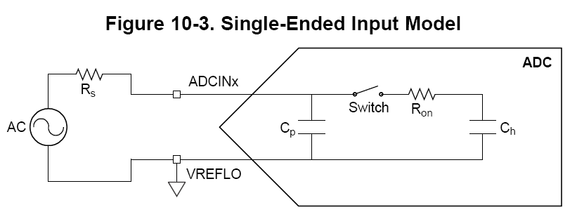
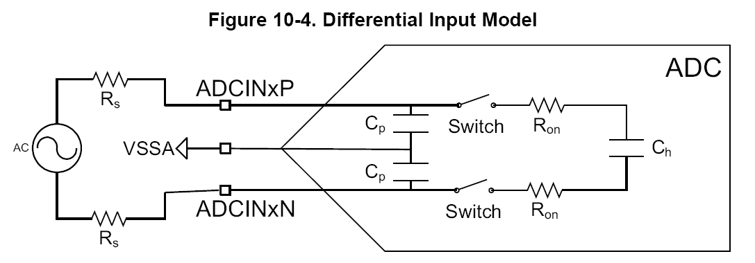
Analog Subsystem
ADC input models

Slide 69
ADC Subsystem
*** Multiple ADC modules allow simultaneous sampling or independent operation ***

Slide 70
ADC Module Block Diagram
ADCIN0
ADCIN1
ADCRESULT0
ADCIN2
ADCRESULT1
ADCIN3
S/H
12/16-bit
A/D
Converter
Result
MUX
ADCRESULT2
MUX
Post Processing Block
ADCIN14
SOCx
ADCIN15
ADCRESULT15
ADC full-scale input range is 0 to 3.3V
CHSEL
ADC
Generation
Logic
EOCx
ADC
Interrupt
Logic
ADCINT1-4
SOCx Signal
ADCINT1
ADCINT2
SOC0 TRIGSEL CHSEL ACQPS
SOC1 TRIGSEL CHSEL ACQPS
SOC2 TRIGSEL CHSEL ACQPS
SOC3 TRIGSEL CHSEL ACQPS
SOC15 TRIGSEL CHSEL ACQPS
Software
CPU1 Timer (0,1,2)
SOCx Triggers
EPWMxSOCA/C (x = 1 to 12)
EPWMxSOCB/D (x = 1 to 12)
External Pin(GPIO/ADCEXTSOC)
CPU2 Timer (0,1,2)
SOCx Configuration Registers

Slide 71
ADC SOCx Functional Diagram
ADCSOCFRC1
Software Trigger
TINT0 (CPU1 Timer 0)
TINT1 (CPU1 Timer 1)
TINT2 (CPU1 Timer 2)
ADCEXTSOC (GPIO)
SOCA/C (ePWM1)
SOCB/D (ePWM1)
SOCA/C (ePWM12)
SOCB/D (ePWM12)
TINT0 (CPU2 Timer 0)
TINT1 (CPU2 Timer 1)
TINT2 (CPU2 Timer 2)
ADCSOCxCTL
T
r
i
g
g
e
r
ADCRESULTx
ADCINT1
ADCINT2
ADCINT3
ADCINT4
Channel
Select
Sample
Window
Result
Register
S
O
C
x
E
O
C
x
ADCINTSOCSEL1
ADCINTSOCSEL2
INTSELxNy
ADCINT1
ADCINT2
Re-Trigger
This block diagram is replicated 16 times

Slide 72
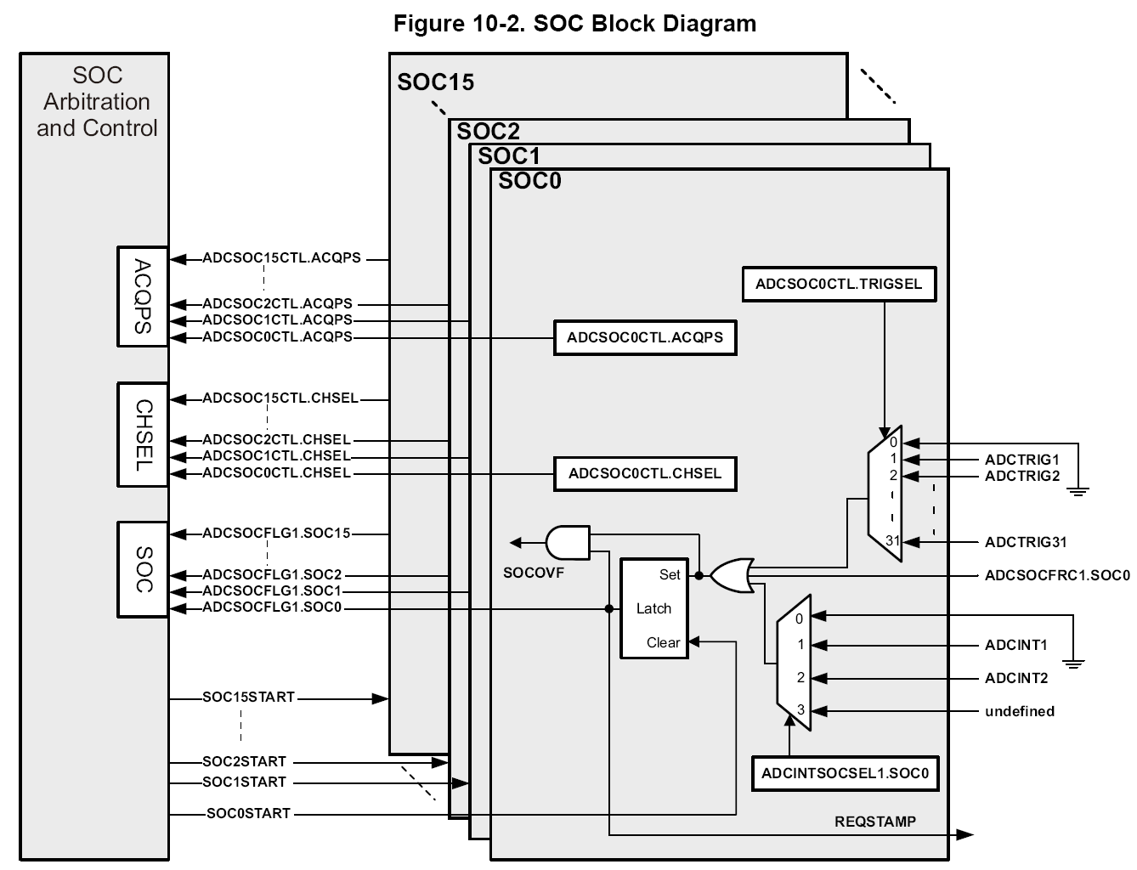
ADC SOCx Functional Diagram

Slide 73
Example – ADC Triggering
Sample A0 → A2 → A5 when ePWM1 SOCB/D is generated and then generate ADCINT1:
SOCB/D (ETPWM1)
SOC0
Channel
A0
Sample
7 cycles
no interrupt
Result0
SOC1
Channel
A2
Sample
10 cycles
no interrupt
Result1
SOC2
Channel
A5
Sample
8 cycles
ADCINT1
Result2
Sample A2 → A4 → A6 continuously and generate ADCINT2:
Software Trigger
no interrupt
Sample
10 cycles
Channel
A2
SOC3
Result3
no interrupt
Sample
15 cycles
Channel
A4
SOC4
Result4
ADCINT2
ADCINT2
Sample
12 cycles
Channel
A6
SOC5
Result5
Note: setting ADCINT2 flag does not need to generate an interrupt

Slide 74
Example – ADC Ping-Pong Triggering
Sample all channels continuously and provide Ping-Pong interrupts to CPU/system:
Software Trigger
SOC0
Channel
B0
Sample
7 cycles
Result0
no interrupt
ADCINT2
SOC1
Channel
B1
Sample
7cycles
Result1
no interrupt
SOC2
Channel
B2
Sample
7 cycles
ADCINT1
Result2
Software Trigger
SOC3
Channel
B3
Sample
7 cycles
ADCINT1
Result3
no interrupt
SOC4
Channel
B4
Sample
7 cycles
no interrupt
Result4
SOC5
Channel
B5
Sample
7 cycles
ADCINT2
Result5

Slide 75
ADC Conversion Priority
When multiple SOC flags are set at the same time – priority determines the order in which they are converted
Round Robin Priority (default)
No SOC has an inherent higher priority than another
Priority depends on the round robin pointer
High Priority
High priority SOC will interrupt the round robin wheel after current conversion completes and insert itself as the next conversion
After its conversion completes, the round robin wheel will continue where it was interrupted
Round Robin Burst Mode
Allows a single trigger to convert one or more SOCs in the round robin wheel
Uses BURSTTRIG instead of TRIGSEL for all round robin SOCs (not high priority)

Slide 76
Conversion Priority Functional Diagram
SOC0
SOC Priority
Determines cutoff point
for high priority and
round robin mode
SOC1
High Priority
SOC2
SOC3
SOC4
SOC5
SOCPRIORITY
SOC6
AdcRegs.SOCPRICTL
SOC7
SOC8
RRPOINTER
SOC9
Round Robin Pointer
Points to the last converted
round robin SOCx and
determines order
of conversions
Round Robin
SOC10
SOC11
SOC12
SOC13
SOC14
SOC15

Slide 77
Round Robin Burst Mode Diagram
AdcxRegs.ADCBURSTCTL
Burst Enable
Disables/enables burst mode
BURSTEN
BURSTSIZE
SOC Burst Size
Determines how many SOCs are converted per burst trigger
BURSTTRIGSEL
Software, CPU1 Timer0-2
ePWM1 ADCSOCA/C – B/D → ePWM12 ADCSOCA/C – B/D
CPU2 Timer0-2
SOC Burst Trigger Source Select
Determines which trigger starts a burst conversion sequence

Slide 78
Purpose of the Post Processing Block
Offset Correction
Remove an offset associated with an ADCIN channel possibly caused by external sensors and signal sources
Zero-overhead; saving cycles
Error from Setpoint Calculation
Subtract out a reference value which can be used to automatically calculate an error from a set-point or expected value
Reduces the sample to output latency and software overhead
Limit and Zero-Crossing Detection
Automatically perform a check against a high/low limit or zero-crossing and can generate a trip to the ePWM and/or an interrupt
Decreases the sample to ePWM latency and reduces software overhead; trip the ePWM based on an out of range ADC conversion without CPU intervention
Trigger-to-Sample Delay Capture
Capable of recording the delay between when the SOC is triggered and when it begins to be sampled
Allows software techniques to reduce the delay error

Slide 79
Post Processing Block - Diagram
ADC Event Status Register
補償因外部元件造成
的準位偏差
雙極性或誤差計算
ADCEVTINTSEL
Register設定
Limit and zero-crossing detection

Slide 80
Post Processing Block Interrupt Event
Each ADC module contains four (4) Post Processing Blocks
Each Post Processing Block and be associated with any of the 16 ADCRESULTx registers

Slide 81
Digital-to-Analog Converter
Three buffered 12-bit DACs
Provides a programmable reference output voltage
Capable of driving an external load
Ability to be synchronized with PWMSYNC events
Selectable reference voltage

Slide 82
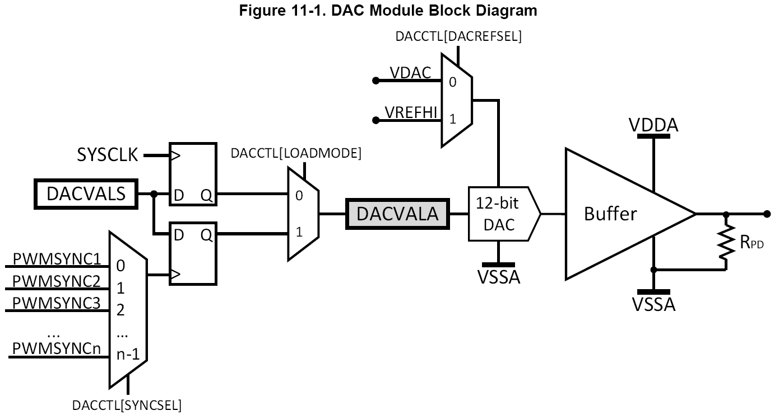
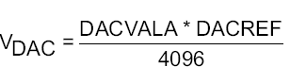
DAC Module
External
reference
DACREF
Unipolar
output
voltage
GND
Ability to synchronize
with PWMSYNC

Slide 83
Buffered DAC Block Diagram
DACREFSEL
V_{DAC}
V_{REFHI}
0
1
V_{DDA}
DACOUTEN
DACVALS
DACVALA
12-bit
DAC
V_{DACOUT}
AMP
V_{SSA}
V_{SSA}
V_{REFLO}
0
1
DACREFSEL
Ideal Output
DACVALA * DACREF
4096
VREFHIA can supply reference for DAC A and DAC B; VREFHIB can supply reference for DAC C
V_{DACOUT} =

Slide 84
Comparator Subsystem
Eight Comparator Subsystems (CMPSS)
Each CMPSS has:
Two analog comparators
Two programmable 12-bit DACs
Two digital filters
Ramp generator
Digital filter used to remove spurious trip signals (majority vote)
Ramp generator used peak current mode control
Ability to synchronize with PWMSYNC event

Slide 85
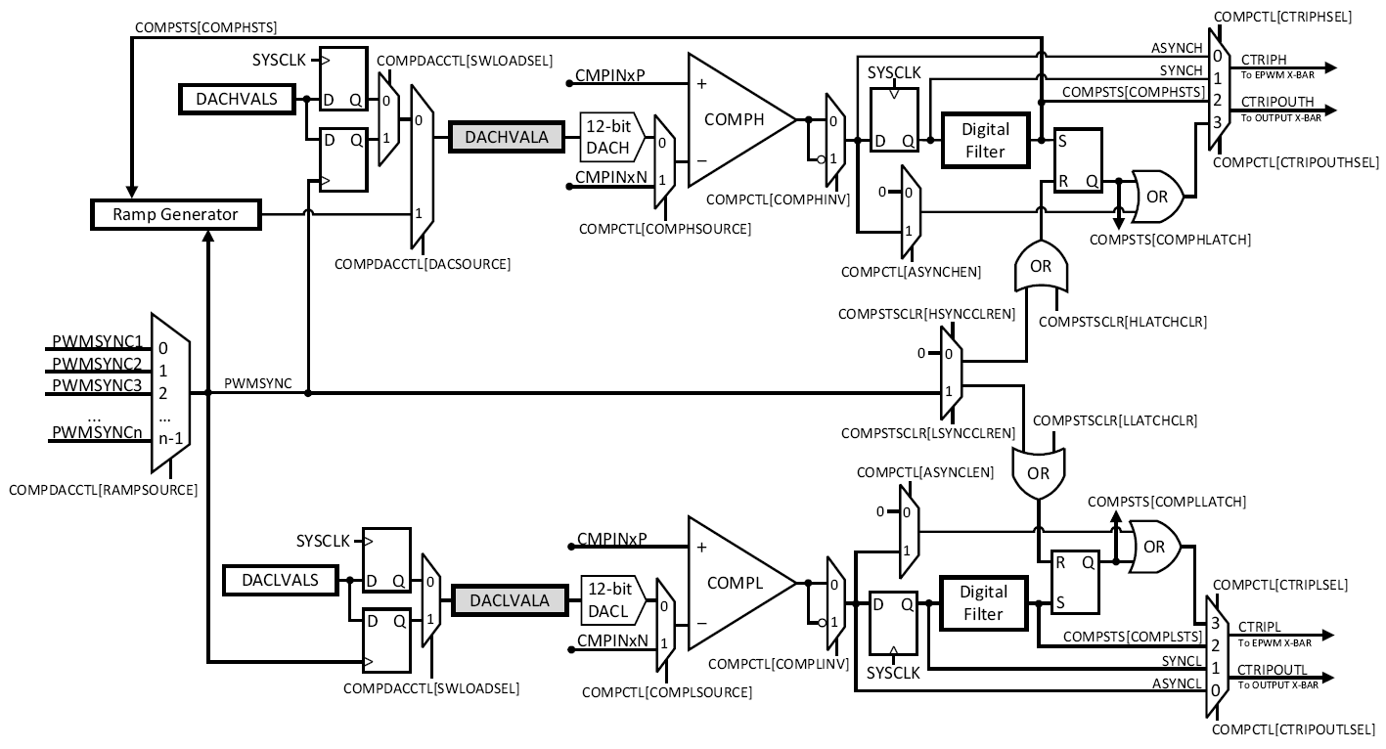
Comparator Subsystem Block Diagram

Slide 86
Comparator Subsystem Block Diagram
CMPINxP
COMPDACE
+
COMPH
-
CTRIPH
1
0
0
1
Digital Filter
DACHVALS
0
1
12-bit
DAC
DACHVALA
ePWM
Event
Trigger
&
GPIO
MUX
COMPHINV
CTRIPOUTH
COMPHSOURCE
DACSOURCE
+
COMPL
-
CTRIPL
CMPINxN
0
1
1
0
Digital Filter
DACLVALS
DACLVALA
12-bit
DAC
COMPLINV
CTRIPOUTL
COMPLSOURCE
DAC Reference
Comparator Truth Table
DACxVALA * DACREF
4096
Voltages Output
Voltage A < Voltage B 0
Voltage A > Voltage B 1
V_{DACx} =

Slide 87
Sigma Delta Filter Module (SDFM)
SDFM is a four-channel digital filter designed specifically for current measurement and resolver position decoding in motor control applications
Each channel can receive an independent modulator bit stream
Bit streams are processed by four individually programmable digital decimation filters
Filters include a fast comparator for immediate digital threshold comparisons for over-current monitoring
Filter-bypass mode available to enable data logging, analysis, and customized filtering

Slide 88
SDFM Block Diagram

Slide 89
Lab 2: Analog-to-Digital Converter
Toggle
(GPIO8)
DACB
data
memory
ADC
CPU copies result
to buffer during
ADC ISR
connector
wire
RESULT0
ADCINA0
pointer rewind
...
ePWM2 triggering
ADC on period match using SOCA trigger every 20 µs (50 kHz)
View ADC buffer PWM Samples
Code Composer
Studio
ePWM2

Slide 90
Outline
Workshop Introduction
Architectural Overview
Programming Development Environment
Lab 1: Using Code Composer Studio with the F2837xD
Reset, Interrupts and System Initialization
Analog Subsystem
Lab 2: Configuring the ADC as a data acquisition system
Control Peripherals
Lab 3: Generating a PWM waveform
Inter-Processor Communications (IPC)
Lab 4: Data transfer using Inter-Processor Communications
Support Resources

Slide 91
ePWM Module Signals and Connections
ePWMx-1
EPWMxSYNCI
EPWMxTZINT
INPUT
X-Bar
PIE
CLA
EPWMxINT
EQEPERR – TZ4
EPWMxA
eQEP
ePWMx
GPIO
MUX
CLOCKFAIL – TZ5
EPWMxB
SYSCTRL
EMUSTOP – TZ6
CPU
EPWMxSOCA
ePWM
X-Bar
EPWMxSOCB
ADC
EPWMxSYNCO
ePWMx+1

Slide 92
ePWM Block Diagram
EPWMCLK
Event Trigger
Clock
Prescaler
Compare
Registers
Compare
Registers
16-Bit
Time-Base
Counter
Compare
Logic
Action
Qualifier
Dead
Band
TBCLK
EPWMxSYNCI
EPWMxSYNCO
Period
Register
EPWMxA
PWM
Chopper
Trip
Zone
EPWMxB
TZy
Digital
Compare
TZ1-TZ3
INPUT X-Bar
ePWM X-Bar

Slide 93
ePWM Time-Base Sub-Module
EPWMCLK
Event Trigger
Clock
Prescaler
Compare
Registers
Compare
Registers
16-Bit
Time-Base
Counter
Compare
Logic
Action
Qualifier
Dead
Band
TBCLK
EPWMxSYNCI
EPWMxSYNCO
Period
Register
EPWMxA
PWM
Chopper
Trip
Zone
EPWMxB
TZy
Digital
Compare
TZ1-TZ3
INPUT X-Bar
ePWM X-Bar

Slide 94
ePWM Time-Base Count Modes
TBCTR
TBPRD
Asymmetrical
Waveform
Count Up Mode
TBCTR
TBPRD
Asymmetrical
Waveform
Count Down Mode
TBCTR
TBPRD
Symmetrical
Waveform
Count Up and Down Mode

Slide 95
ePWM Phase Synchronization
Ext. SyncIn
SyncIn
Phase
En
.
φ=0°
o
o
EPWM1A
o
CTR=zero
o
CTR=CMPB *
o
o
EPWM1B
X
o
SyncOut
To eCAP1
SyncIn
SyncIn
Phase
En
.
φ=120°
o
o
EPWM2A
φ=120°
o
CTR=zero
o
CTR=CMPB *
o
o
EPWM2B
X
o
SyncOut
SyncIn
Phase
En
.
φ=120°
φ=240°
o
o
EPWM3A
o
CTR=zero
o
CTR=CMPB *
o
o
EPWM3B
X
o
SyncOut
φ=240°
* Extended selection for CMPC and CMPD available

Slide 96
ePWM Compare Sub-Module
EPWMCLK
Event Trigger
Clock
Prescaler
Compare
Registers
Compare
Registers
16-Bit
Time-Base
Counter
Compare
Logic
Action
Qualifier
Dead
Band
TBCLK
EPWMxSYNCI
EPWMxSYNCO
Period
Register
EPWMxA
PWM
Chopper
Trip
Zone
EPWMxB
TZy
Digital
Compare
TZ1-TZ3
INPUT X-Bar
ePWM X-Bar

Slide 97
ePWM Compare Event Waveforms
.
TBCTR
= compare events are fed to the Action Qualifier Sub-Module
.
.
.
TBPRD
.
.
.
.
.
.
CMPA
Asymmetrical
Waveform
CMPB
.
.
.
.
Count Up Mode
TBCTR
.
.
.
TBPRD
.
.
.
CMPA
.
.
.
.
.
.
.
Asymmetrical
Waveform
CMPB
Count Down Mode
TBCTR
.
.
TBPRD
.
.
.
.
CMPA
.
.
.
.
.
.
.
Symmetrical
Waveform
CMPB
Count Up and Down Mode
CMPC and CMPD available for use as event triggers

Slide 98
ePWM Action Qualifier Sub-Module
EPWMCLK
Event Trigger
Clock
Prescaler
Compare
Registers
Compare
Registers
16-Bit
Time-Base
Counter
Compare
Logic
Action
Qualifier
Dead
Band
TBCLK
EPWMxSYNCI
EPWMxSYNCO
Period
Register
EPWMxA
PWM
Chopper
Trip
Zone
EPWMxB
TZy
Digital
Compare
TZ1-TZ3
INPUT X-Bar
ePWM X-Bar

Slide 99
ePWM Action Qualifier Actions for EPWMA and EPWMB
Time-Base Counter equals:
Trigger Events:
EPWM
Output
Actions
S/W
Force
Zero
CMPA
CMPB
TBPRD
T1
T2
SW
X
Z
X
CA
X
CB
X
P
X
T1
X
T2
X
Do Nothing
SW
↓
Z
↓
CA
↓
CB
↓
P
↓
T1
↓
T2
↓
Clear Low
SW
↑
Z
↑
CA
↑
CB
↑
P
↑
T1
↑
T2
↑
Set High
SW
T
Z
T
CA
T
CB
T
P
T
T1
T
T2
T
Toggle
Tx Event Sources = DCAEVT1, DCAEVT2, DCBEVT1, DCBEVT2, TZ1, TZ2, TZ3, EPWMxSYNCIN

Slide 100
ePWM Count Up Asymmetric Waveform with Independent Modulation on EPWMA / B
TBCTR
.
.
TBPRD
.
.
CMPA
.
.
CMPB
.
.
.
Z
↑
P
X
CB
X
CA
↓
Z
↑
P
X
CB
X
CA
↓
Z
↑
P
X
EPWMA
Z
↑
P
X
CB
↓
CA
X
Z
↑
P
X
CB
↓
CA
X
Z
↑
P
X
EPWMB
Notes:
The next few figures show how the action qualifier uses the compare matches to modulate the output pins. Notice that the output pins for EPWMA and EPWMB are completely independent. Here, on the EPWMA output, the waveform will be set high on zero match and clear low on compare A match. On the EPWMB output, the waveform will be set high on zero match and clear low on compare B match.

Slide 101
ePWM Count Up Asymmetric Waveform with Independent Modulation on EPWMA
TBCTR
.
.
TBPRD
.
.
CMPB
.
.
CMPA
.
.
.
CA
↑
CB
↓
CA
↑
CB
↓
EPWMA
Z
T
Z
T
Z
T
EPWMB
Notes:
This figure has the EPWMA output set high on compare A match and clear low on compare B match, while the EPWMB output is configured to toggle on zero match.

Slide 102
ePWM Count Up-Down Symmetric Waveform with Independent Modulation on EPWMA / B
TBCTR
.
.
TBPRD
.
.
.
.
CMPB
.
.
.
.
CMPA
.
.
.
CA
↑
CA
↓
CA
↑
CA
↓
EPWMA
CB
↑
CB
↓
CB
↑
CB
↓
EPWMB
Notes:
Here you can see that we can have different output actions on the up-count and down-count using a single compare register. So, for the EPWMA and EPWMB outputs, we are setting high on the compare A and B up-count matches and clearing low on the compare A and B down-down matches.

Slide 103
ePWM Count Up-Down Symmetric Waveform with Independent Modulation on EPWMA
TBCTR
.
.
TBPRD
.
.
CMPB
.
.
CMPA
.
.
.
CA
↑
CB
↓
CA
↑
CB
↓
EPWMA
Z
↓
P
↑
Z
↓
P
↑
EPWMB
Notes:
And finally, again using different output actions on the up-count and down-count, we have the EPWMA output set high on the compare A up-count match and clear low on the compare B down-count match. The EPWMB output will clear low on zero match and set high on period match.

Slide 104
ePWM Dead-Band Sub-Module
EPWMCLK
Event Trigger
Clock
Prescaler
Compare
Registers
Compare
Registers
16-Bit
Time-Base
Counter
Compare
Logic
Action
Qualifier
Dead
Band
TBCLK
EPWMxSYNCI
EPWMxSYNCO
Period
Register
EPWMxA
PWM
Chopper
Trip
Zone
EPWMxB
TZy
Digital
Compare
TZ1-TZ3
INPUT X-Bar
ePWM X-Bar

Slide 105
Motivation for Dead-Band
supply rail
gate signals are
complementary PWM
to power switching device
Transistor gates turn on faster than they shut off
Short circuit if both gates are on at same time!

Slide 106
ePWM Dead-Band Block Diagram
.
PWMxA
.
Rising Edge Delay
In Out
(14-bit counter)
0
°
S4
0
°
0
°
S1
0
°
.
°
S2
RED
°
°
S6
PWMxA
1
°
°
°
°
°
1
°
1
1
0
°
DEDB-
MODE
°
.
S8
°
0
1
S7
PWMxB
0
°
.
S3
1
°
1
°
FED
S0
°
0
°
S8
Falling Edge Delay
In Out
(14-bit counter)
°
°
1
.
°
S5
°
°
°
°
°
°
1
°
°
0
0
1
POLSEL
OUT-MODE
OUTSWAP
IN-MODE
.
HALFCYCLE
PWMxB

Slide 107
ePWM Chopper Sub-Module
EPWMCLK
Event Trigger
Clock
Prescaler
Compare
Registers
Compare
Registers
16-Bit
Time-Base
Counter
Compare
Logic
Action
Qualifier
Dead
Band
TBCLK
EPWMxSYNCI
EPWMxSYNCO
Period
Register
EPWMxA
PWM
Chopper
Trip
Zone
EPWMxB
TZy
Digital
Compare
TZ1-TZ3
INPUT X-Bar
ePWM X-Bar

Slide 108
Purpose of the PWM Chopper
Allows a high frequency carrier signal to modulate the PWM waveform generated by the Action Qualifier and Dead-Band modules
Used with pulse transformer-based gate drivers to control power switching elements

Slide 109
ePWM Chopper Waveform
EPWMxA
EPWMxB
CHPFREQ
EPWMxA
EPWMxB
Programmable
Pulse Width
(OSHTWTH)
OSHT
EPWMxA
Sustaining
Pulses
With One-Shot Pulse on EPWMxA and/or EPWMxB

Slide 110
ePWM Trip-Zone and Digital Compare Sub-Module
EPWMCLK
Event Trigger
Clock
Prescaler
Compare
Registers
Compare
Registers
16-Bit
Time-Base
Counter
Compare
Logic
Action
Qualifier
Dead
Band
TBCLK
EPWMxSYNCI
EPWMxSYNCO
Period
Register
EPWMxA
PWM
Chopper
Trip
Zone
EPWMxB
TZy
Digital
Compare
TZ1-TZ3
INPUT X-Bar
ePWM X-Bar

Slide 111
Trip-Zone and Digital Compare Inputs
GPIO
MUX
INPUT
X-BAR
TRIPIN1 & TZ1
TRIPIN2 & TZ2
TRIPIN3 & TZ3
Trip-
Zone
Sub-
Module
TRIPIN6
TRIPIN4
TRIPIN5
ePWM
X-BAR
TRIPIN7
TRIPIN8
TRIPIN9
TRIPIN10
DCAHTRIPSEL
TRIPIN11
DCALTRIPSEL
TRIPIN12
TZ4 TZ5 TZ6
DCBHTRIPSEL
DCBLTRIPSEL
TRIPIN1 & TZ1
TRIPIN2 & TZ2
TRIPIN3 & TZ3
Digital
Compare
Sub-
Module
TRIPIN6
TRIPIN4
12
TRIPIN5
TRIPIN7
TRIPIN8
TRIPIN9
TRIPIN10
TRIPIN11
TRIPIN12
TRIP COMBO
TRIPIN14
TRIPIN15

Slide 112
ePWM X-Bar
CMPSS1
CTRIPOUTH
ePWM
X-Bar
TRIPIN4
All
ePWM
Modules
CTRIPOUTL
TRIPIN5
TRIPIN7
TRIPIN8
TRIPIN9
TRIPIN10
CTRIPOUTH
TRIPIN11
CMPSS8
CTRIPOUTL
TRIPIN12
INPUT1
INPUT2
EPWM/ECAP sync
EXTSYNCOUT
INPUT3
INPUT X-Bar
INPUT4
INPUT5
ADCSOCAO
ADCSOCA
INPUT6
FLT1.COMPH
ADCSOCBO
ADCSOCB
FLT1.COMPL
ADCA
EVT1 to EVT4
SD1
ADCB
EVT1 to EVT4
FLT4.COMPH
ADCC
EVT1 to EVT4
FLT4.COMPL
ADCD
EVT1 to EVT4
FLT1.COMPH
ECAP1
ECAP1.OUT
FLT1.COMPL
ECAP2
ECAP2.OUT
ECAP3
ECAP3.OUT
SD2
ECAP4
ECAP4.OUT
FLT4.COMPH
ECAP5
ECAP5.OUT
FLT4.COMPL
ECAP6
ECAP6.OUT

Slide 113
ePWM X-Bar Architecture
0.1
0.2
0
0.3
TRIPxMUXENABLE
0.4
TRIPxMUX0TO15CFG.MUX0
1.1
1.2
1
TRIPINx
1.3
1.4
TRIPxMUX0TO15CFG.MUX1
TRIPOUTPUTINV
31.1
This block diagram is replicated 8 times
31.2
31
31.3
31.4
TRIPxMUX16TO31CFG.MUX31
MUX | 0 | 1 | 2 | 3
0 | CMPSS1.CTRIPOUTH | CMPSS1.CTRIPH_OR_CTRIPL | ADCAEVT1 | ECAP1.OUT
1 | CMPSS1.CTRIPOUTL | INPUTXBAR1 |  | ADCCEVT1
2 | CMPSS2.CTRIPOUTH | CMPSS2.CTRIPH_OR_CTRIPL | ADCAEVT2 | ECAP2.OUT
3 | CMPSS2.CTRIPOUTL | INPUTXBAR2 |  | ADCCEVT2
4 | CMPSS3.CTRIPOUTH | CMPSS3.CTRIPH_OR_CTRIPL | ADCAEVT3 | ECAP3.OUT
5 | CMPSS3.CTRIPOUTL | INPUTXBAR3 |  | ADCCEVT3
6 | CMPSS4.CTRIPOUTH | CMPSS4.CTRIPH_OR_CTRIPL | ADCAEVT4 | ECAP4.OUT
7 | CMPSS4.CTRIPOUTL | INPUTXBAR4 |  | ADCCEVT4
8 | CMPSS5.CTRIPOUTH | CMPSS5.CTRIPH_OR_CTRIPL | ADCBEVT1 | ECAP5.OUT
9 | CMPSS5.CTRIPOUTL | INPUTXBAR5 |  | ADCDEVT1
10 | CMPSS6.CTRIPOUTH | CMPSS6.CTRIPH_OR_CTRIPL | ADCBEVT2 | ECAP6.OUT
11 | CMPSS6.CTRIPOUTL | INPUTXBAR6 |  | ADCDEVT2
12 | CMPSS7.CTRIPOUTH | CMPSS7.CTRIPH_OR_CTRIPL | ADCBEVT3
13 | CMPSS7.CTRIPOUTL | ADCSOCA |  | ADCDEVT3
14 | CMPSS8.CTRIPOUTH | CMPSS8.CTRIPH_OR_CTRIPL | ADCBEVT4 | EXTSYNCOUT
15 | CMPSS8.CTRIPOUTL | ADCSOCB |  | ADCDEVT4
MUX | 0 | 1 | 2 | 3
16 | SD1FLT1.COMPH | SD1FLT1.COMPH_OR_COMPL
17 | SD1FLT1.COMPL
18 | SD1FLT2.COMPH | SD1FLT2.COMPH_OR_COMPL
19 | SD1FLT2.COMPL
20 | SD1FLT3.COMPH | SD1FLT3.COMPH_OR_COMPL
21 | SD1FLT3.COMPL
22 | SD1FLT4.COMPH | SD1FLT4.COMPH_OR_COMPL
23 | SD1FLT4.COMPL
24 | SD2FLT1.COMPH | SD2FLT1.COMPH_OR_COMPL
25 | SD2FLT1.COMPL
26 | SD2FLT2.COMPH | SD2FLT2.COMPH_OR_COMPL
27 | SD2FLT2.COMPL
28 | SD2FLT3.COMPH | SD2FLT3.COMPH_OR_COMPL
29 | SD2FLT3.COMPL
30 | SD2FLT4.COMPH | SD2FLT4.COMPH_OR_COMPL
31 | SD2FLT4.COMPL

Slide 114
Trip-Zone Features
Trip-Zone has a fast, clock independent logic path to high-impedance the EPWMxA/B output pins
Interrupt latency may not protect hardware when responding to over current conditions or short-circuits through ISR software
Supports: #1) one-shot trip for major short circuits or over current conditions
#2) cycle-by-cycle trip for current limiting operation
Over
Current
Sensors
CPU
core
P
W
M
O
U
T
P
U
T
S
Digital
Compare
EPWMxA
EPWMxTZINT
INPUT X-Bar
Cycle-by-Cycle
Mode
ePWM X-Bar
TZ4
EQEP1ERR
EPWMxB
eQEP1
One-Shot
Mode
TZ5
CLOCKFAIL
SYSCTRL
TZ6
EMUSTOP
CPU

Slide 115
Purpose of the Digital Compare Sub-Module
Generates ‘compare’ events that can:
Trip the ePWM
Generate a Trip interrupt
Sync the ePWM
Generate an ADC start of conversion
Digital compare module inputs are:
Input X-Bar
ePWM X-Bar
Trip-zone input pins
A compare event is generated when one or more of its selected inputs are either high or low
Optional ‘Blanking’ can be used to temporarily disable the compare action in alignment with PWM switching to eliminate noise effects

Slide 116
Digital Compare Sub-Module Signals
Time-Base Sub-Module
DCAH
DCAEVT1
Generate PWM Sync
Digital Trip
Event A1
Compare
TRIPIN1 & TZ1
Event-Trigger Sub-Module
TRIPIN2 & TZ2
blanking
Generate SOCA
TRIPIN3 & TZ3
Digital Trip
Event A2
Compare
Trip-Zone Sub-Module
TRIPIN4
DCAL
Trip PWMA Output
Generate Trip Interrupt
●
DCAEVT2
●
●
Time-Base Sub-Module
DCBH
DCBEVT1
Generate PWM Sync
TRIPIN12
Digital Trip
Event B1
Compare
Event-Trigger Sub-Module
TRIPIN14
Generate SOCB
TRIPIN15
blanking
Digital Trip
Event B2
Compare
Trip-Zone Sub-Module
TRIP COMBO
DCBL
Trip PWMB Output
Generate Trip Interrupt
DCBEVT2
DCTRIPSEL
TZDCSEL
DCACTL / DCBCTL

Slide 117
Digital Compare Events
The user selects the input for each of DCAH, DCAL, DCBH, DCBL
Each A and B compare uses its corresponding DCyH/L inputs (y = A or B)
The user selects the signal state that triggers each compare from the following choices:
DCyH → low DCyL → don’t care
DCyH → high DCyL → don’t care
iii. DCyL → low DCyH → don’t care
iv. DCyL → high DCyH → don’t care
v. DCyL → high DCyH → low

Slide 118
ePWM Event-Trigger Sub-Module
EPWMCLK
Event Trigger
Clock
Prescaler
Compare
Registers
Compare
Registers
16-Bit
Time-Base
Counter
Compare
Logic
Action
Qualifier
Dead
Band
TBCLK
EPWMxSYNCI
EPWMxSYNCO
Period
Register
EPWMxA
PWM
Chopper
Trip
Zone
EPWMxB
TZy
Digital
Compare
TZ1-TZ3
INPUT X-Bar
ePWM X-Bar

Slide 119
ePWM Event-Trigger Interrupts and SOC
TBCTR
.
.
.
.
.
.
TBPRD
.
.
.
.
CMPD
.
.
.
.
CMPC
.
.
.
.
CMPB
.
.
.
CMPA
CTR = 0
CTR = PRD
CTR = 0 or PRD
CTRU = CMPA
CTRD = CMPA
CTRU = CMPB
CTRD = CMPB
CTRU = CMPC
CTRD = CMPC
CTRU = CMPD
CTRD = CMPD

Slide 120
Hi-Resolution PWM (HRPWM)
PWM Period
Regular PWM Step
(i.e. 10 ns)
Device Clock
(i.e. 100 MHz)
(fixed Time-Base/2)
HRPWM divides a clock cycle into smaller steps
called Micro Steps
(Step Size ~= 150 ps)
Calibration Logic tracks the number of Micro Steps per clock to account for variations caused by Temp/Volt/Process
ms
ms
ms
ms
ms
ms
Calibration Logic
HRPWM
Micro Step (~150 ps)
Significantly increases the resolution of conventionally derived digital PWM
Uses 8-bit extensions to Compare registers (CMPxHR), Period register (TBPRDHR) and Phase register (TBPHSHR) for edge positioning control
Typically used when PWM resolution falls below ~9-10 bits which occurs at frequencies greater than ~200 kHz (with system clock of 100 MHz)
Not all ePWM outputs support HRPWM feature (see device datasheet)

Slide 121
Capture Module (eCAP)
Timer
Trigger
pin
Timestamp
Values
The eCAP module timestamps transitions on a capture input pin
Can be used to measure the time width of a pulse
Auxiliary PWM generation
t₁
t₂

Slide 122
eCAP Module Block Diagram – Capture Mode
CAP1POL
Capture 1
Register
Polarity
Select 1
CAP2POL
Capture 2
Register
Polarity
Select 2
PRESCALE
32-Bit
Time-Stamp
Counter
Event
Prescale
Event Logic
CAP3POL
ECAPx
pin
Capture 3
Register
Polarity
Select 3
CPUx.SYSCLK
CAP4POL
Capture 4
Register
Polarity
Select 4

Slide 123
eCAP Module Block Diagram – APWM Mode
Shadowed
Period
Register
(CAP3)
Period
Register
(CAP1)
shadow
mode
immediate
mode
32-Bit
Time-Stamp
Counter
PWM
Compare
Logic
ECAP
pin
CPUx.SYSCLK
Compare
Register
(CAP2)
immediate
mode
Compare
Register
(CAP4)
shadow
mode
Shadowed

Slide 124
What is an Incremental Quadrature Encoder?
A digital (angular) position sensor
photo sensors spaced θ/4 deg. apart
slots spaced θ deg. apart
θ/4
light source (LED)
θ
Ch. A
Ch. B
shaft rotation
Incremental Optical Encoder
Quadrature Output from Photo Sensors

Slide 125
How is Position Determined from Quadrature Signals?
Position resolution is θ/4 degrees
increment
counter
decrement
counter
(00)
(11)
(A,B) =
10
(10)
(01)
Ch. A
Illegal Transitions; generate phase error interrupt
00
11
Ch. B
01
Quadrature Decoder
State Machine

Slide 126
eQEP Module Block Diagram
Measure the elapsed time between the unit position events; used for low speed measurement
Quadrature
Capture
Generate periodic interrupts for velocity calculations
Direction -count mode
Quadrature -clock mode
Monitors the quadrature clock to indicate proper operation of the motion control system
Quadrature
Decoder
EQEPxA/XCLK
32-Bit Unit
Time-Base
EQEPxB/XDIR
QEP
Watchdog
EQEPxI
CPUx.SYSCLK
EQEPxS
Position/Counter
Compare
Generate the direction and clock for the position counter in quadrature count mode
Generate a sync output and/or interrupt on a position compare match

Slide 127
eQEP Module Connections
Ch. A
Quadrature
Capture
Ch. B
Quadrature
Decoder
EQEPxA/XCLK
32-Bit Unit
Time-Base
EQEPxB/XDIR
QEP
Watchdog
EQEPxI
Index
CPUx.SYSCLK
EQEPxS
Strobe
from homing sensor
Position/Counter
Compare

Slide 128
Lab 3: Control Peripherals
PWM1A
AdcaResults
TB Counter
Compare
Action Qualifier
connector
wire
ADCA
RESULT0
SYNC
ADCA0
...
pointer rewind
CPU copies
results to
buffers during
ADC ISR
PWM5A
Phase
TB Counter
Compare
Action Qualifier
connector
wire
ADCC
AdccResults
RESULT0
PWM1 period = programmable
PWM1 duty = programmable
PWM5 period = synchronized
PWM5 duty = programmable
PWM5 phase = programmable
ADCC3
...
pointer rewind
PWM2 triggering
ADC on period match using SOCA trigger every 20 µs (50 kHz)
View both ADC buffers
PWM2
Code Composer
Studio
Notes:
This foil describes the lab flow.
Connector wire: used to select the desired input to the ADC.
GP Timer 2: used to auto-trigger the ADC at a 50kHz rate.
The ADC will send an interrupt to the CPU when each conversion is done. Note that we are taking an ADC interrupt on every conversion (IM=0 in ADCTRL2), rather than on every other conversion. We could have written the code to do the later if we had wanted to, and saved some CPU interrupt overhead.
In the ADC ISR, the CPU will read the ADC result FIFO, and write the result into the data memory allocated for use as the results buffer. The CPU will then increment the pointer into the buffer, and check to see if the end of the buffer has been reached. If so, the pointer is rewound to the beginning of the buffer.
The contents of the buffer will be plotted in Code Explorer.

Slide 129
Outline
Workshop Introduction
Architectural Overview
Programming Development Environment
Lab 1: Using Code Composer Studio with the F2837xD
Reset, Interrupts and System Initialization
Analog Subsystem
Lab 2: Configuring the ADC as a data acquisition system
Control Peripherals
Lab 3: Generating a PWM waveform
Inter-Processor Communications (IPC)
Lab 4: Data transfer using Inter-Processor Communications
Support Resources

Slide 130
IPC Device Features
Allows Communications Between the Two CPU Subsystems
Global Shared SARAM
Message SARAM
IPC Message Registers
IPC Interrupts and Flags
Clock Configuration Semaphore
Flash Pump Semaphore
Free Running Counter

Slide 131
IPC Global Shared SARAM
Up to 16 Blocks (GS0 – GS15)
4K words each Block
Can be configured to be used by CPU1 or CPU2
Typically used by the application
Also can be used to pass messages
Ownership | CPU1 Subsystem |  | CPU2 Subsystem
 | CPU1 | CPU1.DMA | CPU2 | CPU2.DMA
CPU1 Subsystem* | R/W/Exe | R/W | R | R
CPU2 Subsystem | R | R | R/W/Exe | R/W
* default

Slide 132
IPC Message SARAM
2 Blocks
1K words each Block
Used to pass messages or data between CPU1 and CPU2
Always enabled – configuration is fixed
Message RAM | CPU1 Subsystem |  | CPU2 Subsystem
 | CPU1 | CPU1.DMA | CPU2 | CPU2.DMA
CPU1 to CPU2 (“C1toC2”) | R/W | R/W | R | R
CPU2 to CPU1 (“C2toC1”) | R | R | R/W | R/W

Slide 133
IPC Message Registers
Provides very simple and flexible messaging
Dedicated registers mapped to both CPU’s
The definition (what the register content means) is up to the application software
TI’s IPC-Lite drivers use the IPC message registers
Local Register Name | Local CPU | Remote CPU | Remote Register Name
IPCSENDCOM | R/W | R | IPCRECVCOM
IPCSENDADDR | R/W | R | IPCRECVADDR
IPCSENDDATA | R/W | R | IPCRECVDATA
IPCREMOTEREPLY | R | R/W | IPCLOCALREPLY

Slide 134
IPC Interrupts and Flags
CPU1 to CPU2: 32 flags with 4 interrupts
CPU2 to CPU1: 32 flags with 4 interrupts
Requesting CPU→ Set, Flag and Clear registers
Register
IPCSET | Message waiting (send interrupt and/or set flag)
IPCFLG | Bit is set by the “SET” register
IPCCLR | Clear the flag
Receiving CPU → Status and Acknowledge registers
Register
IPCSTS | Status (reflects the FLG bit)
IPCACK | Clear STS and FLG
Prefix indicates request and receive CPU:
C1TOC2IPCSET / C2TOC1IPCSET

Slide 135
Messaging with IPC Flags and Interrupts

Slide 136
Basic IPC Data Transfer
Basic option – no software drivers needed and easy to use!
Use the message SARAM’s and global shared SARAM’s (GSx blocks) to pass data between processors at a known address
Use the IPC flag registers to tell the other processor that the data is ready
CPU1 Application
CPU2 Application
1: Write a message to C1toC2 MSG RAM
Message
3: sees C1TOC2IPCSTS bit is set
C1toC2 MSG RAM
C2toC1 MSG RAM
4: read message
2: Write 1 to C1TOC2IPCSET bit
GSx Shared SARAM’s
5: write 1 to C1TOC2IPCACK bit
C1TOC2IPCFLG
C1TOC2IPCSTS

Slide 137
IPC Software Solutions Summary
Basic Option
No software drivers needed
Uses IPC registers only (simple message passing)
IPC-Lite Software API Driver
Uses IPC registers only (no memory used)
Limited to 1 IPC interrupt at a time
Limited to 1 command/message at a time
CPU1 can use IPC-Lite to communicate with CPU2 boot ROM
Main IPC Software API Driver
Uses circular buffers message RAMs
Can queue up to 4 messages prior to processing (configurable)
Can use multiple IPC ISRs at a time
Requires additional setup in application code prior to use

Slide 138
Lab 4: Inter-Processor Communications
CPU1
CPU2
IPC1 receive ISR
Reads IPC1 data and writes into DAC-B
Sine Table
DAC-B
DACVALS
IPCRECVADDR
IPC1
IPCSENDADDR
...
pointer rewind
Pin 09
IPC2 receive ISR
Reads IPC2 data and stores in circular buffer
Writes next sine data to IPC1
connector
wire
ADCA EOC ISR
Reads ADC result and writes to IPC2
Adc Results
ADC-A
RESULT0
IPCSENDDATA
IPC2
IPCRECVDATA
...
pointer rewind
Pin 11
View ADC buffer
PWM2 triggers
ADCA at 50 kHz
Code Composer
Studio
Notes:
This foil describes the lab flow.
Connector wire: used to select the desired input to the ADC.
GP Timer 2: used to auto-trigger the ADC at a 50kHz rate.
The ADC will send an interrupt to the CPU when each conversion is done. Note that we are taking an ADC interrupt on every conversion (IM=0 in ADCTRL2), rather than on every other conversion. We could have written the code to do the later if we had wanted to, and saved some CPU interrupt overhead.
In the ADC ISR, the CPU will read the ADC result FIFO, and write the result into the data memory allocated for use as the results buffer. The CPU will then increment the pointer into the buffer, and check to see if the end of the buffer has been reached. If so, the pointer is rewound to the beginning of the buffer.
The contents of the buffer will be plotted in Code Explorer.

Slide 139
Outline
Workshop Introduction
Architectural Overview
Programming Development Environment
Lab 1: Using Code Composer Studio with the F2837xD
Reset, Interrupts and System Initialization
Analog Subsystem
Lab 2: Configuring the ADC as a data acquisition system
Control Peripherals
Lab 3: Generating a PWM waveform
Inter-Processor Communications (IPC)
Lab 4: Data transfer using Inter-Processor Communications
Support Resources

Slide 140
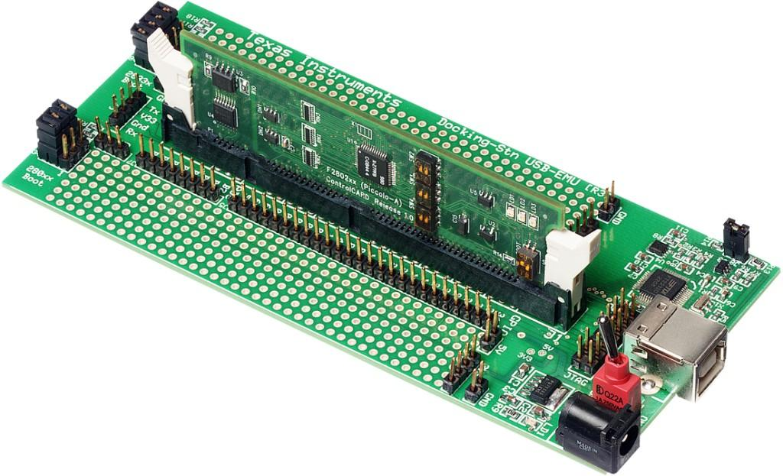
C2000 MCU Multi-day Training Course
TMS320F2806x Workshop Outline
- Architectural Overview
- Programming Development Environment
- Peripheral Register Header Files
- Reset and Interrupts
- System Initialization
- Analog-to-Digital Converter
- Control Peripherals
- Numerical Concepts
- Direct Memory Access (DMA)
- Control Law Accelerator (CLA)
- Viterbi, Complex Math, CRC Unit (VCU)
- System Design
- Communications
- Support Resources
In-depth hands-on TMS320F28069 Design and Peripheral Training

Slide 141
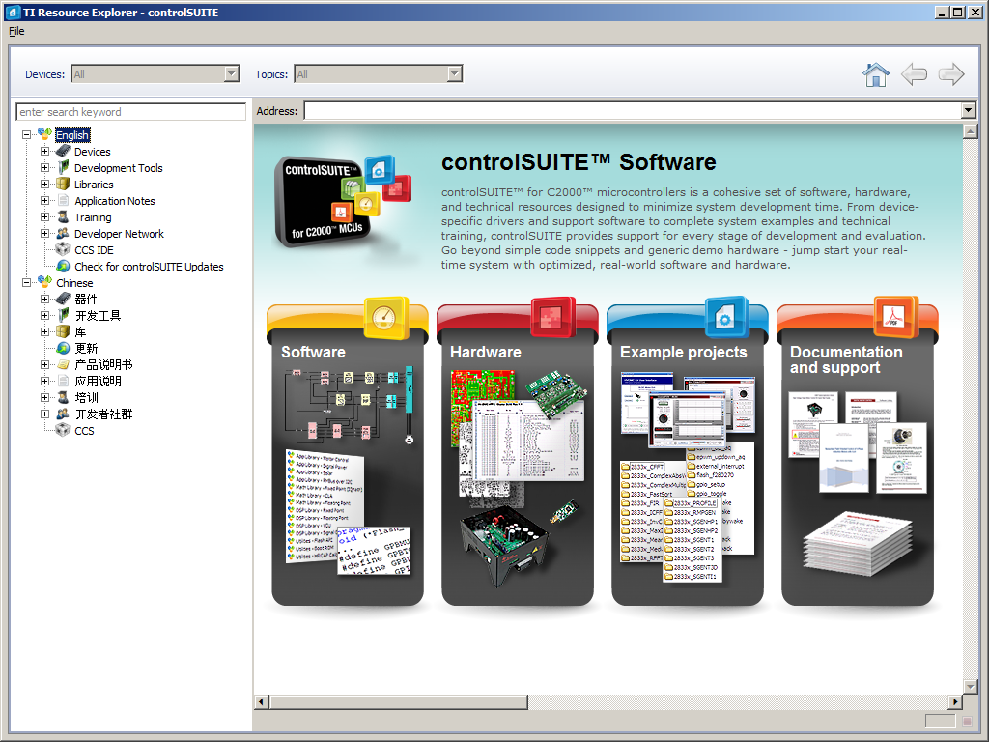
controlSUITE™

Slide 142
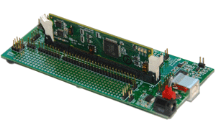
C2000 Experimenter’s Kit F28069, F28035, F28027, F28335, F2808, C28343, C28346, F28M35, F28377D
Experimenter Kits include
controlCARD
USB docking station
C2000 Applications Software CD with example code and full hardware details
Code Composer Studio
Docking station features
Access to controlCARD signals
Breadboard areas
Onboard USB JTAG Emulation
JTAG emulator not required
Available through TI authorized distributors and the TI eStore
Part Number:
TMDSDOCK28069
TMDSDOCK28035
TMDSDOCK28027
TMDSDOCK28335
TMDSDOCK2808
TMDSDOCKH52C1
TMDSDOCK28377D
JTAG emulator required for:
TMDSDOCK28343
TMDSDOCK28346-168

Slide 143
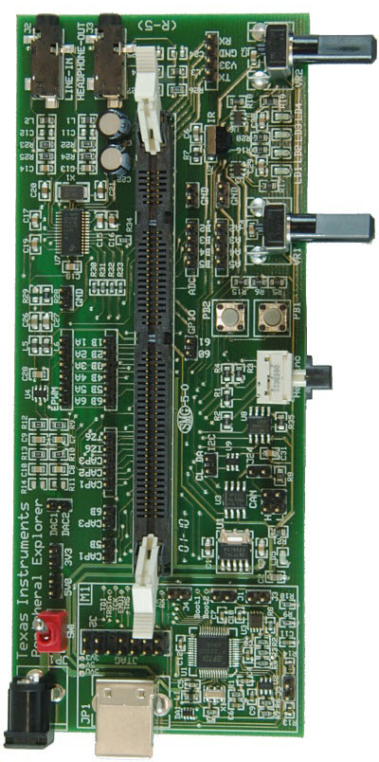
F28335 Peripheral Explorer Kit
Experimenter Kit includes
F28335 controlCARD
Peripheral Explorer baseboard
C2000 Applications Software CD with example code and full hardware details
Code Composer Studio
Peripheral Explorer features
ADC input variable resistors
GPIO hex encoder & push buttons
eCAP infrared sensor
GPIO LEDs, I2C & CAN connection
Analog I/O (AIC+McBSP)
Onboard USB JTAG Emulation
JTAG emulator not required
Available through TI authorized distributors and the TI eStore
TMDSPREX28335

Slide 144
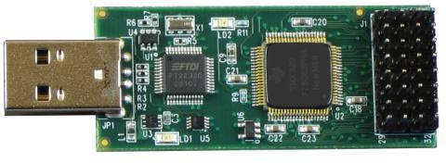
C2000 controlSTICK Evaluation Tool F28069, F28027
Low-cost USB evaluation tool
Onboard JTAG Emulation
JTAG emulator not required
Access to controlSTICK signals
C2000 Applications Software CD with example code and full hardware details
Code Composer Studio
Available through TI authorized distributors and the TI eStore
Part Number:
TMDX28069USB
TMDS28027USB

Slide 145
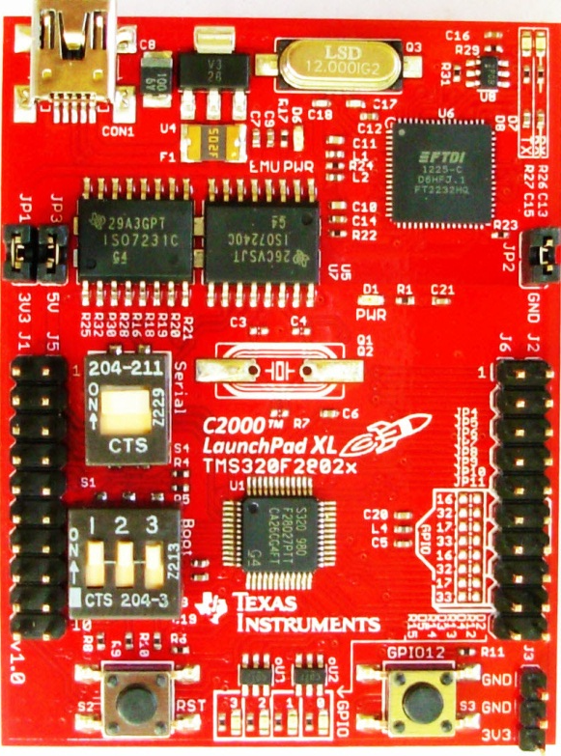
C2000 LaunchPad Evaluation Kit F28027, F28027F, F28069M, F28075
Low-cost evaluation kit
F28027 and F28075 standard version
F28027F version with InstaSPIN-FOC
F28069M version with InstaSPIN-MOTION
Various BoosterPacks available
Onboard JTAG Emulation
JTAG emulator not required
Access to LaunchPad signals
C2000 Applications Software with example code and full hardware details in available in controlSUITE
Code Composer Studio
Available through TI authorized distributors and the TI eStore
Part Number:
LAUNCHXL-F28027
LAUNCHXL-F28027F
LAUNCHXL-F28069M
LAUNCHXL-F28075

Slide 146
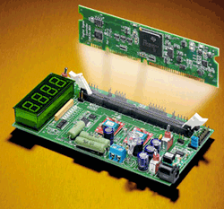
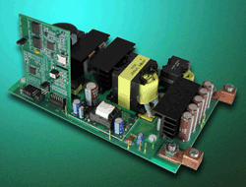
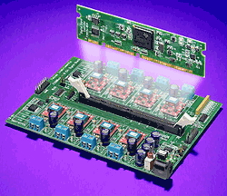
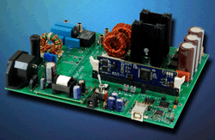
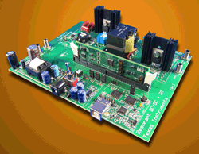
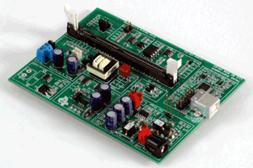
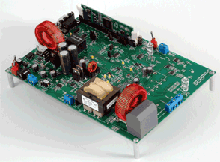
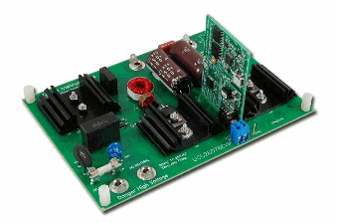
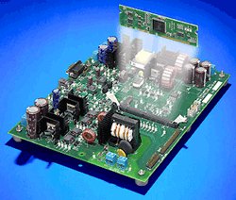
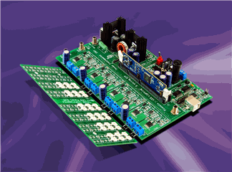
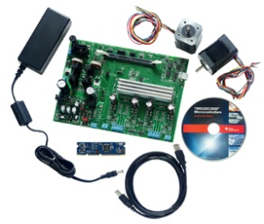
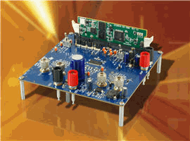
C2000 controlCARD Application Kits
Developer’s Kit for – Motor Control, PFC, High Voltage, Digital Power, Renewable Energy, LED Lighting, etc.
Kits includes
controlCARD and application specific baseboard
Code Composer Studio
Software download includes
Complete schematics, BOM, gerber files, and source code for board and all software
Quick-start demonstration GUI for quick and easy access to all board features
Fully documented software specific to each kit and application
See www.ti.com/c2000 for other kits and more details
Available through TI authorized distributors and the TI eStore

Slide 147
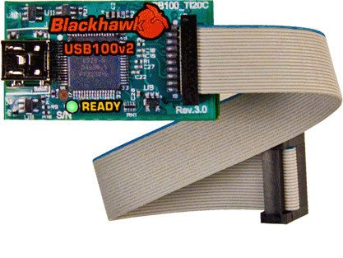
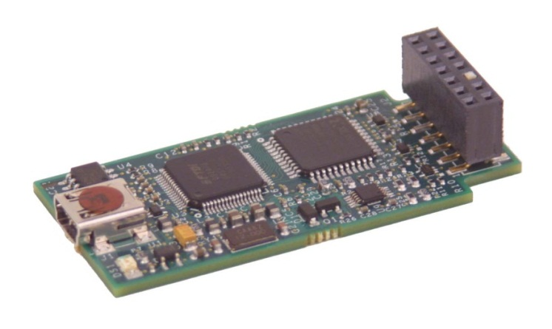
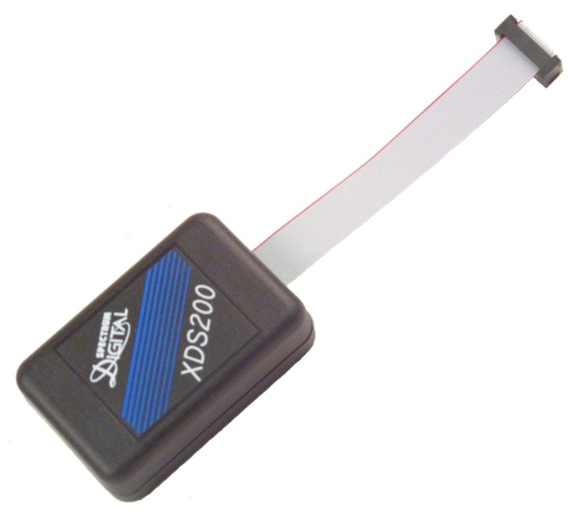
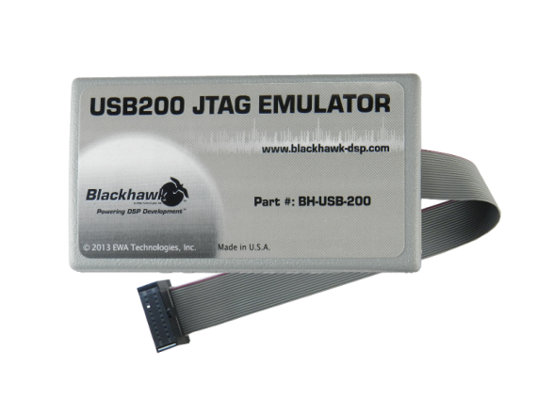
XDS100 / XDS200 Class JTAG Emulators
Blackhawk
USB100v2
Spectrum Digital
XDS100v2
Blackhawk
USB200
Spectrum Digital
XDS200
www.blackhawk-dsp.com
www.spectrumdigital.com

Slide 148

C2000 Workshop Download Wiki
http://www.ti.com/hands-on-training

Slide 149
For More Information . . .
USA – Product Information Center (PIC)
Phone: 800-477-8924 or 512-434-1560
E-mail: support@ti.com
TI E2E Community (videos, forums, blogs)
http://e2e.ti.com
Embedded Processor Wiki
http://processors.wiki.ti.com
TI Training
http://www.ti.com/training
TI eStore
http://estore.ti.com
TI website
http://www.ti.com

Slide 150

Technical Training Organization
www.ti.com/training

